Slide 1

AUGMENTED REALITY CLASSROOM
Ajinkya Gavane, Iszzy Hennes, Caroline Law, Hasham Mukhtar

Slide 2
Agenda:
Approach
Design
Technology - Epson 350
Questions we needed to answer
Challenges Faced and Lessons Learned
Tools
Implementation
Future Work

Slide 3
APPROACH
Our group is being challenged to create a new age version of powerpoint and other outdated presentation methods that are better suited for today’s technological generation.
The idea is that we want to design an augmented reality experience with which a whole classroom can interact with using AR smart glasses.
This new form of presentation will not only be visually appealing, but interactive, hopefully allowing students to learn at their own pace and for the professor to guide the class in a more involved way.
Notes:
Ajinkya

Slide 4
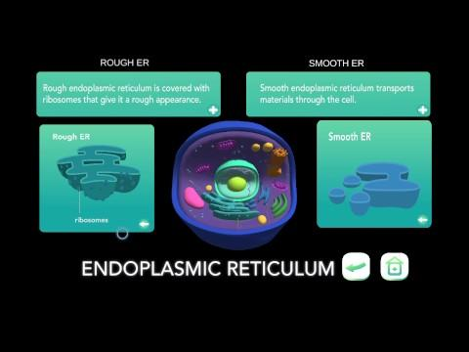
DEMO

Slide 5
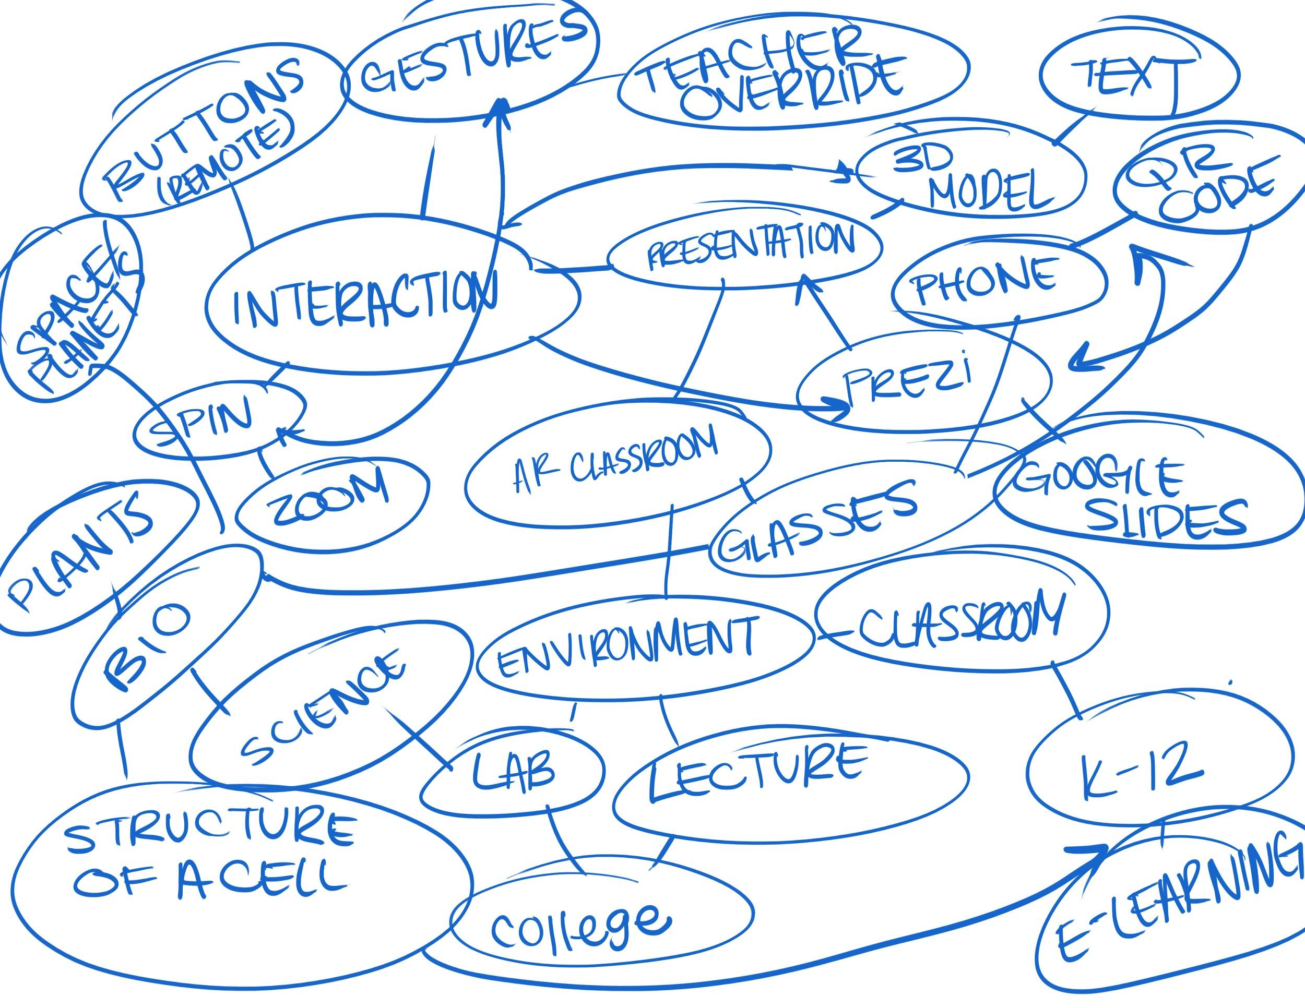
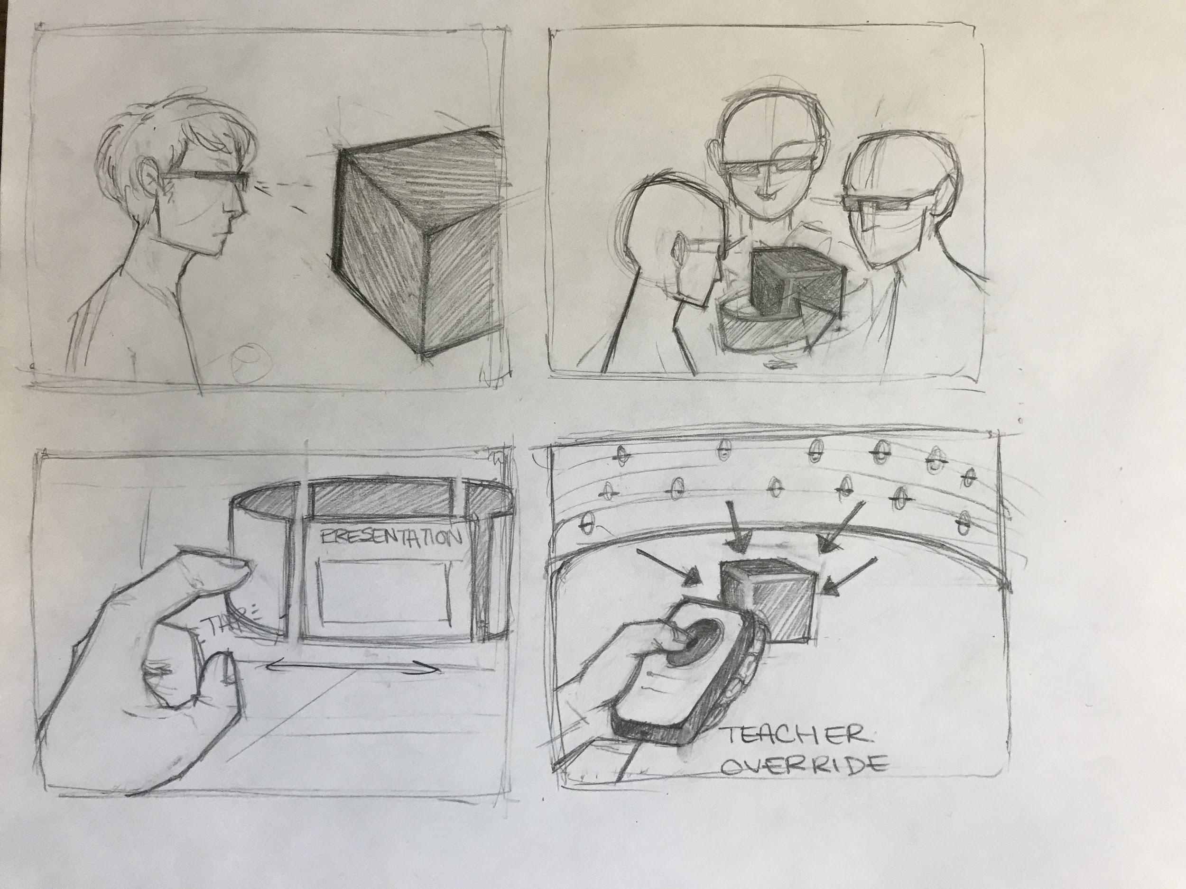
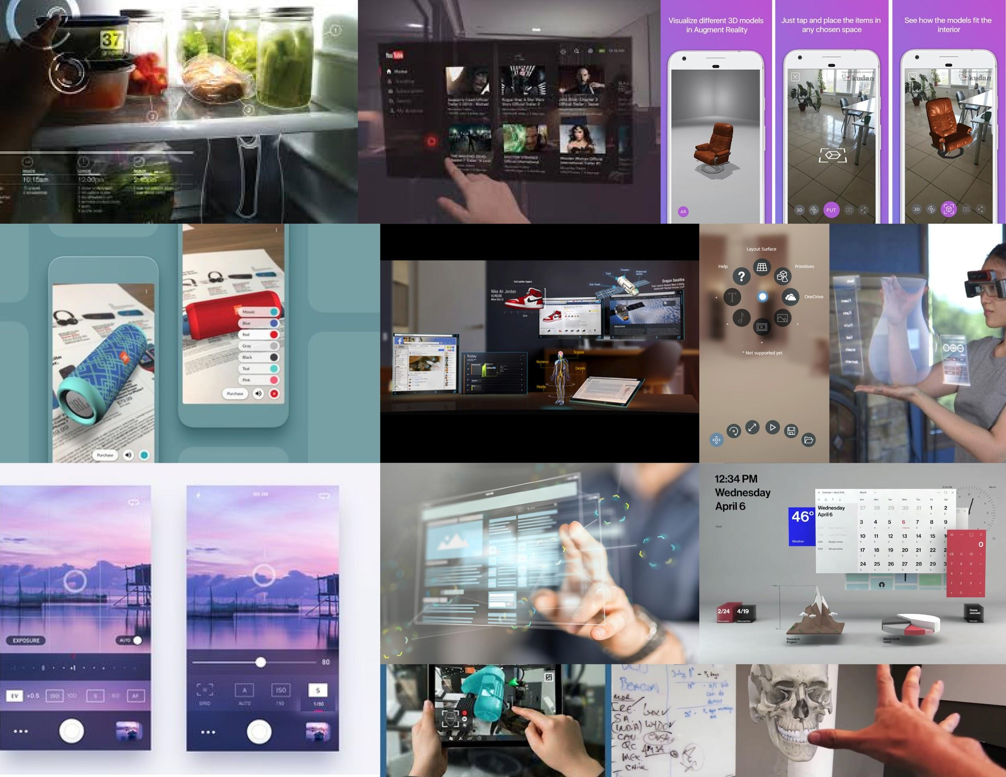
Notes:
Isszy

Slide 6
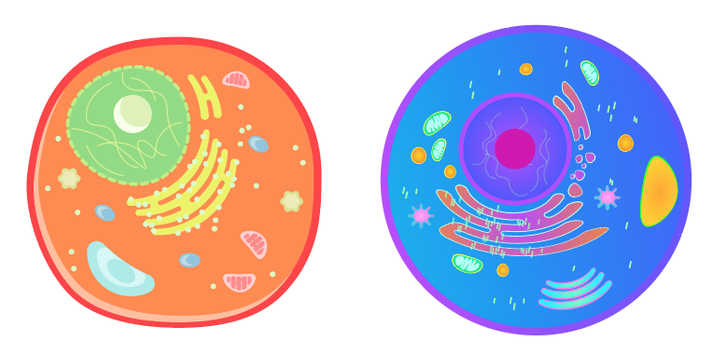


Slide 7
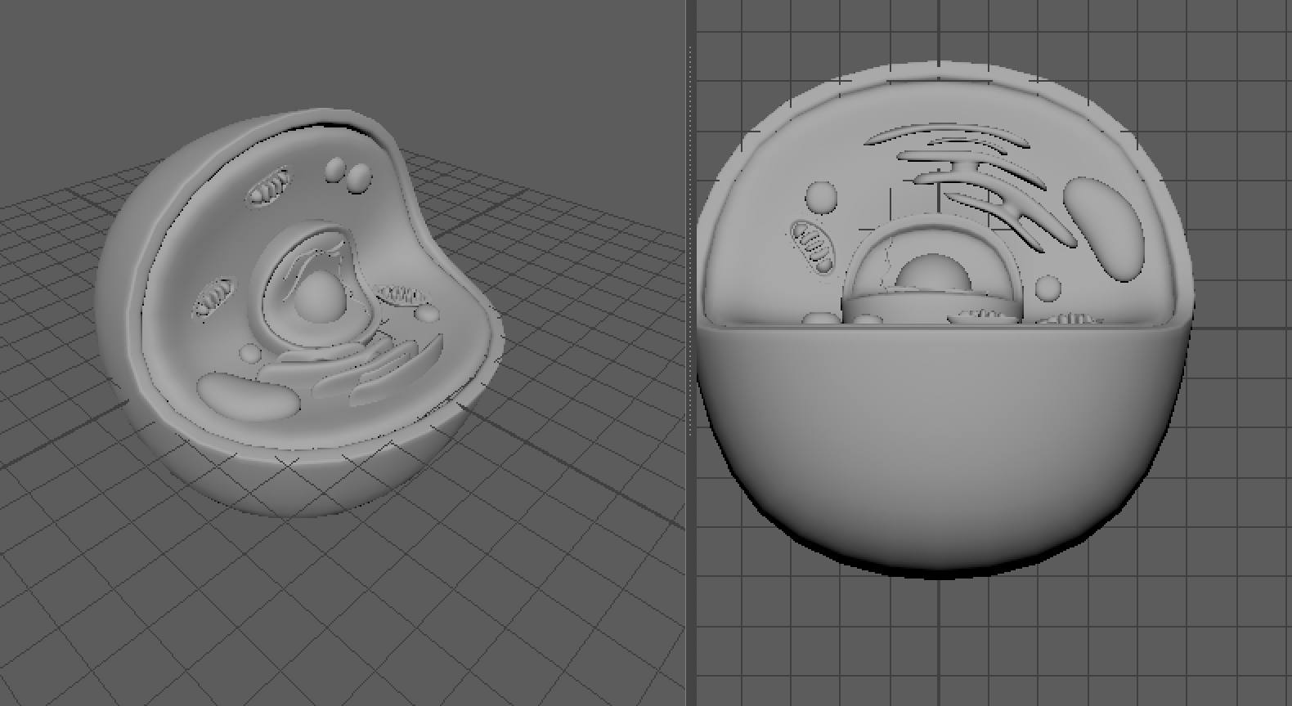

Slide 8
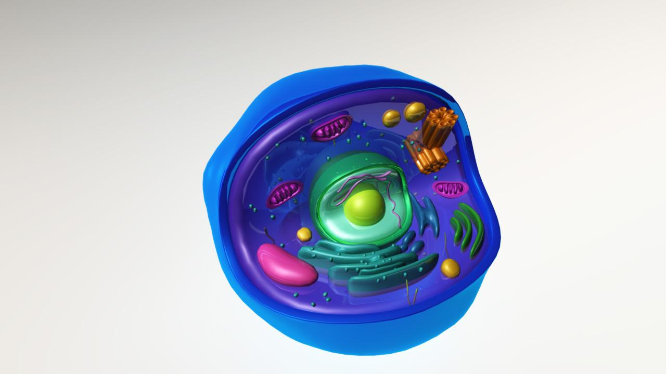

Slide 9
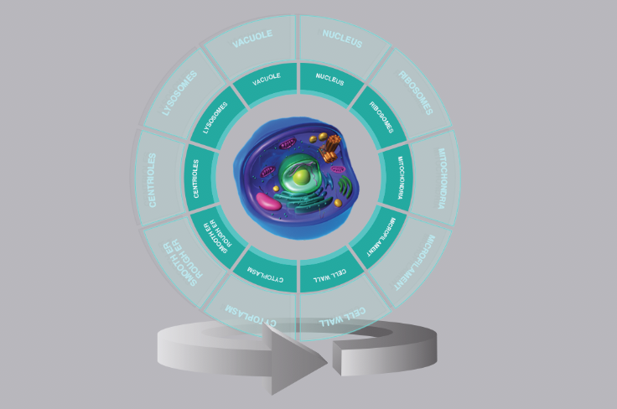
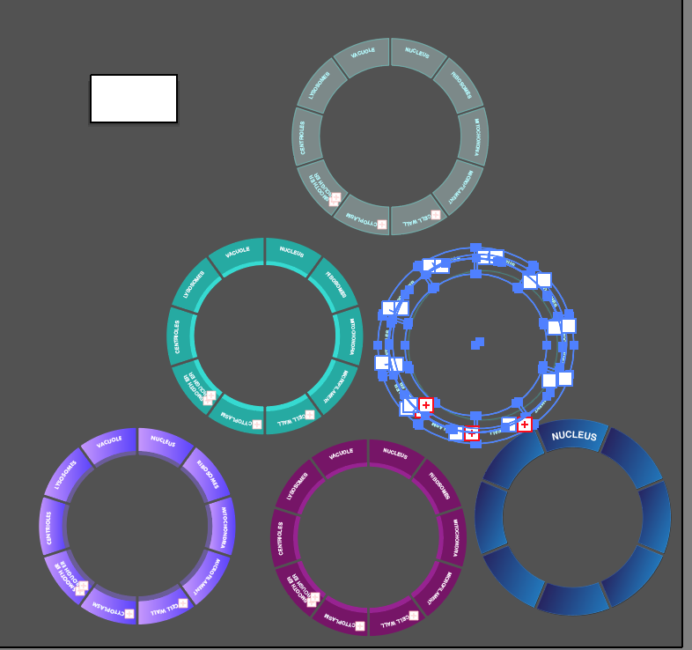

Slide 10
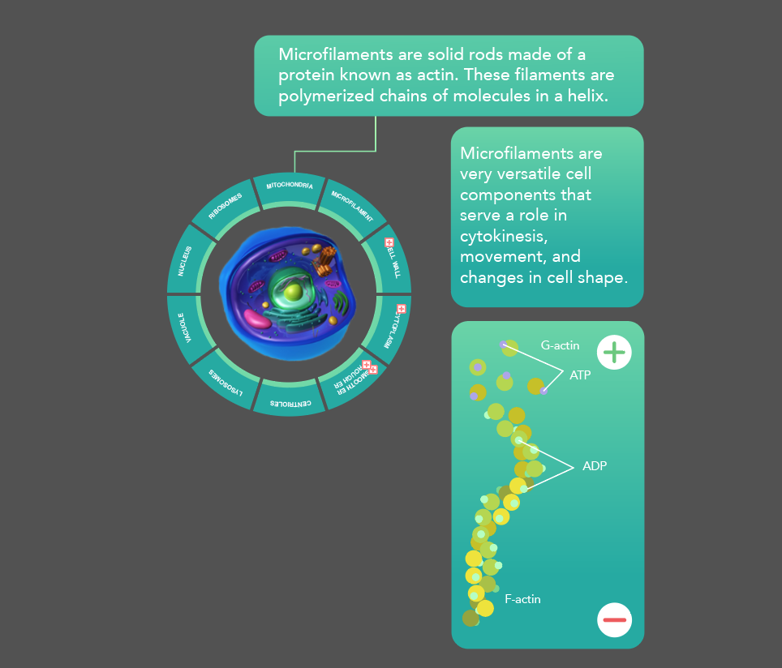
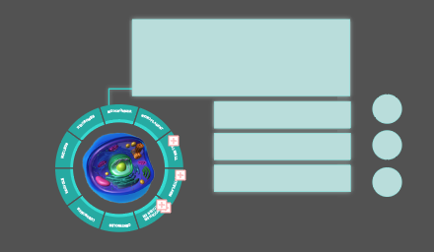
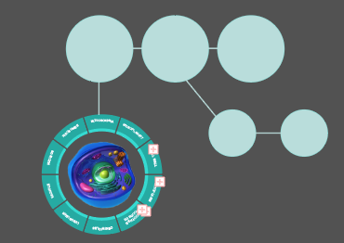
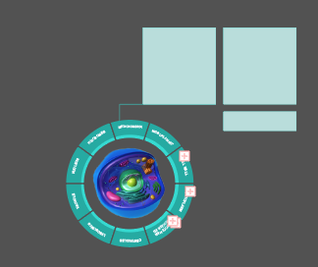

Slide 11
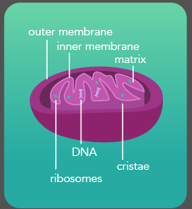
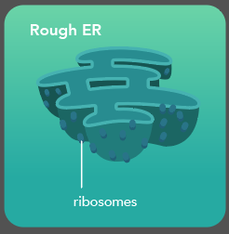
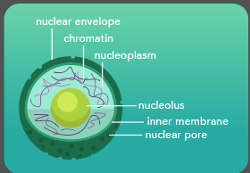
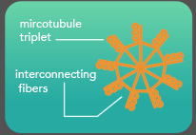
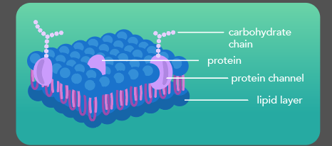

Slide 12
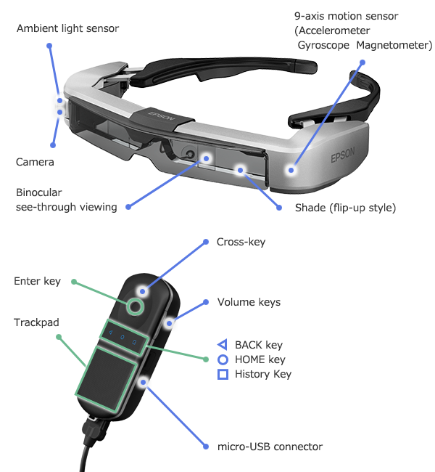
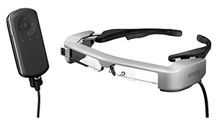
TECHNOLOGY
EPSON MOVERIO
BT - 350
Notes:
Hasham

Slide 13





DEVELOPMENT AND DESIGN TOOLS
Android SDK
Unity
Scripts written in C#
Autodesk Maya
Adobe Illustrator
Notes:
Caroline

Slide 14
QUESTIONS
Perspective of Presentation?
Presenter will guide the class through the model
Audience can look at the model and interact with it to get more information
Gestures/Interaction?
Touch interface like a phone screen with a cursor
What will we see?
The model and information is static
The viewer will be able to see the 3D model and the presenter at the same time
Notes:
Hasham

Slide 15
CHALLENGES & LESSONS LEARNED
The Moverio BT-350
Most support only applies to the BT-200 and BT-300
Very few of the technologies we originally wanted to use was compatible with the BT-350
Not as much screen space as we thought
AR Presentation doesn’t really exist yet
Narrowing our scope was challenging
We wanted to research the capabilities of an AR Presentation
Notes:
Caroline

Slide 16
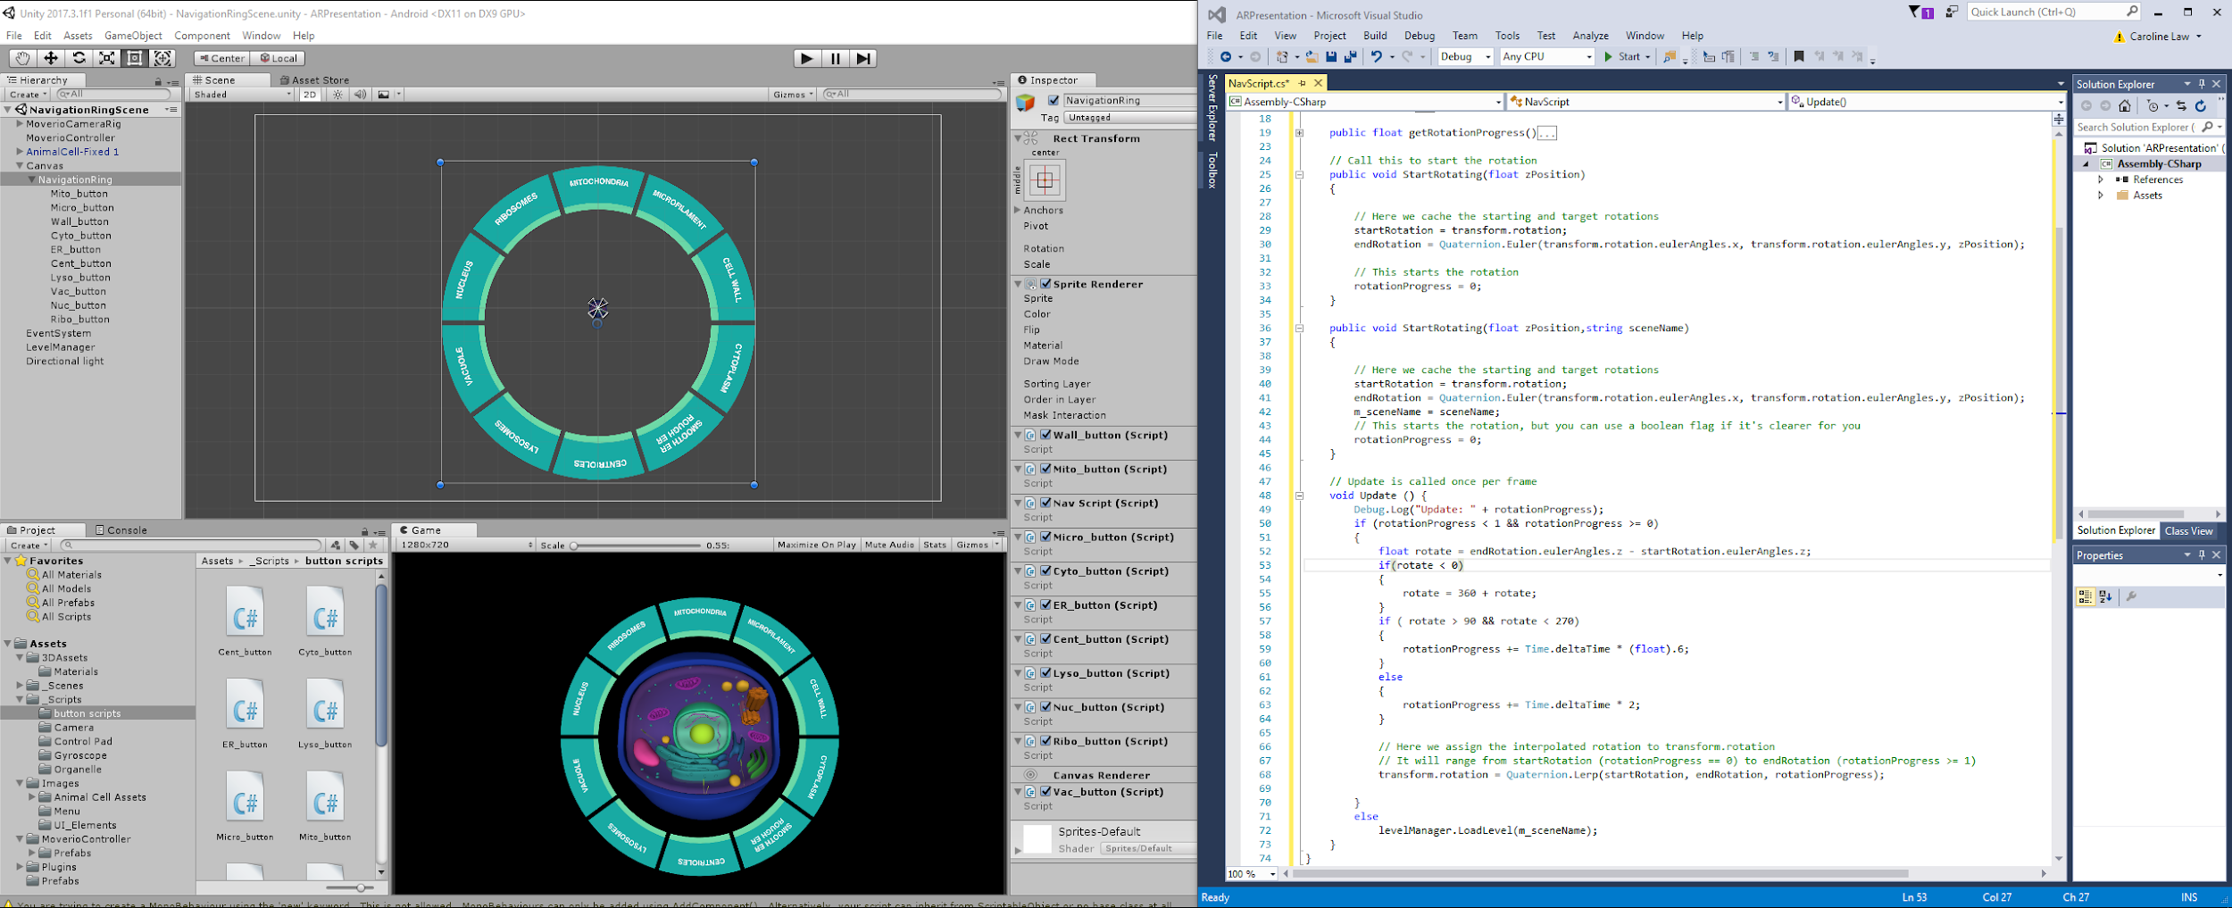
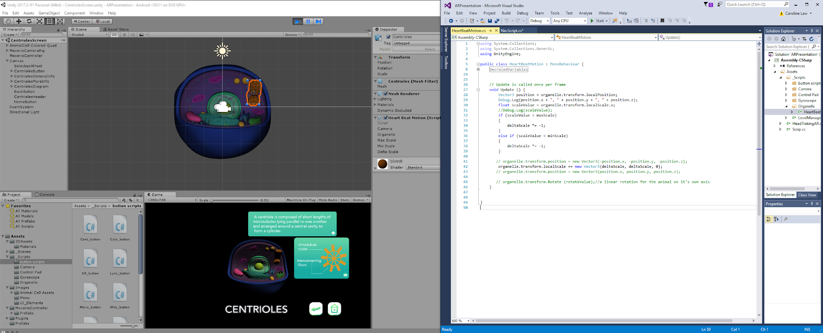
IMPLEMENTED FEATURES
Navigation wheel (slide organization)
Users can push any button and it will go to the top of the wheel
Collapsible information (interactive learning)
Users can view information about each organelle in the cell
Users can go as in depth as they want (different levels of complexity)
Selected organelle in the 3D model will grow and shrink (like a heartbeat)
Notes:
Caroline

Slide 17
FUTURE WORK
Loading other AR Presentations into the app
Gestures (Augmenta)
Multi-user interactions
Fixing wheel animation
Zooming in/out
Notes:
Ajinkya

Slide 18
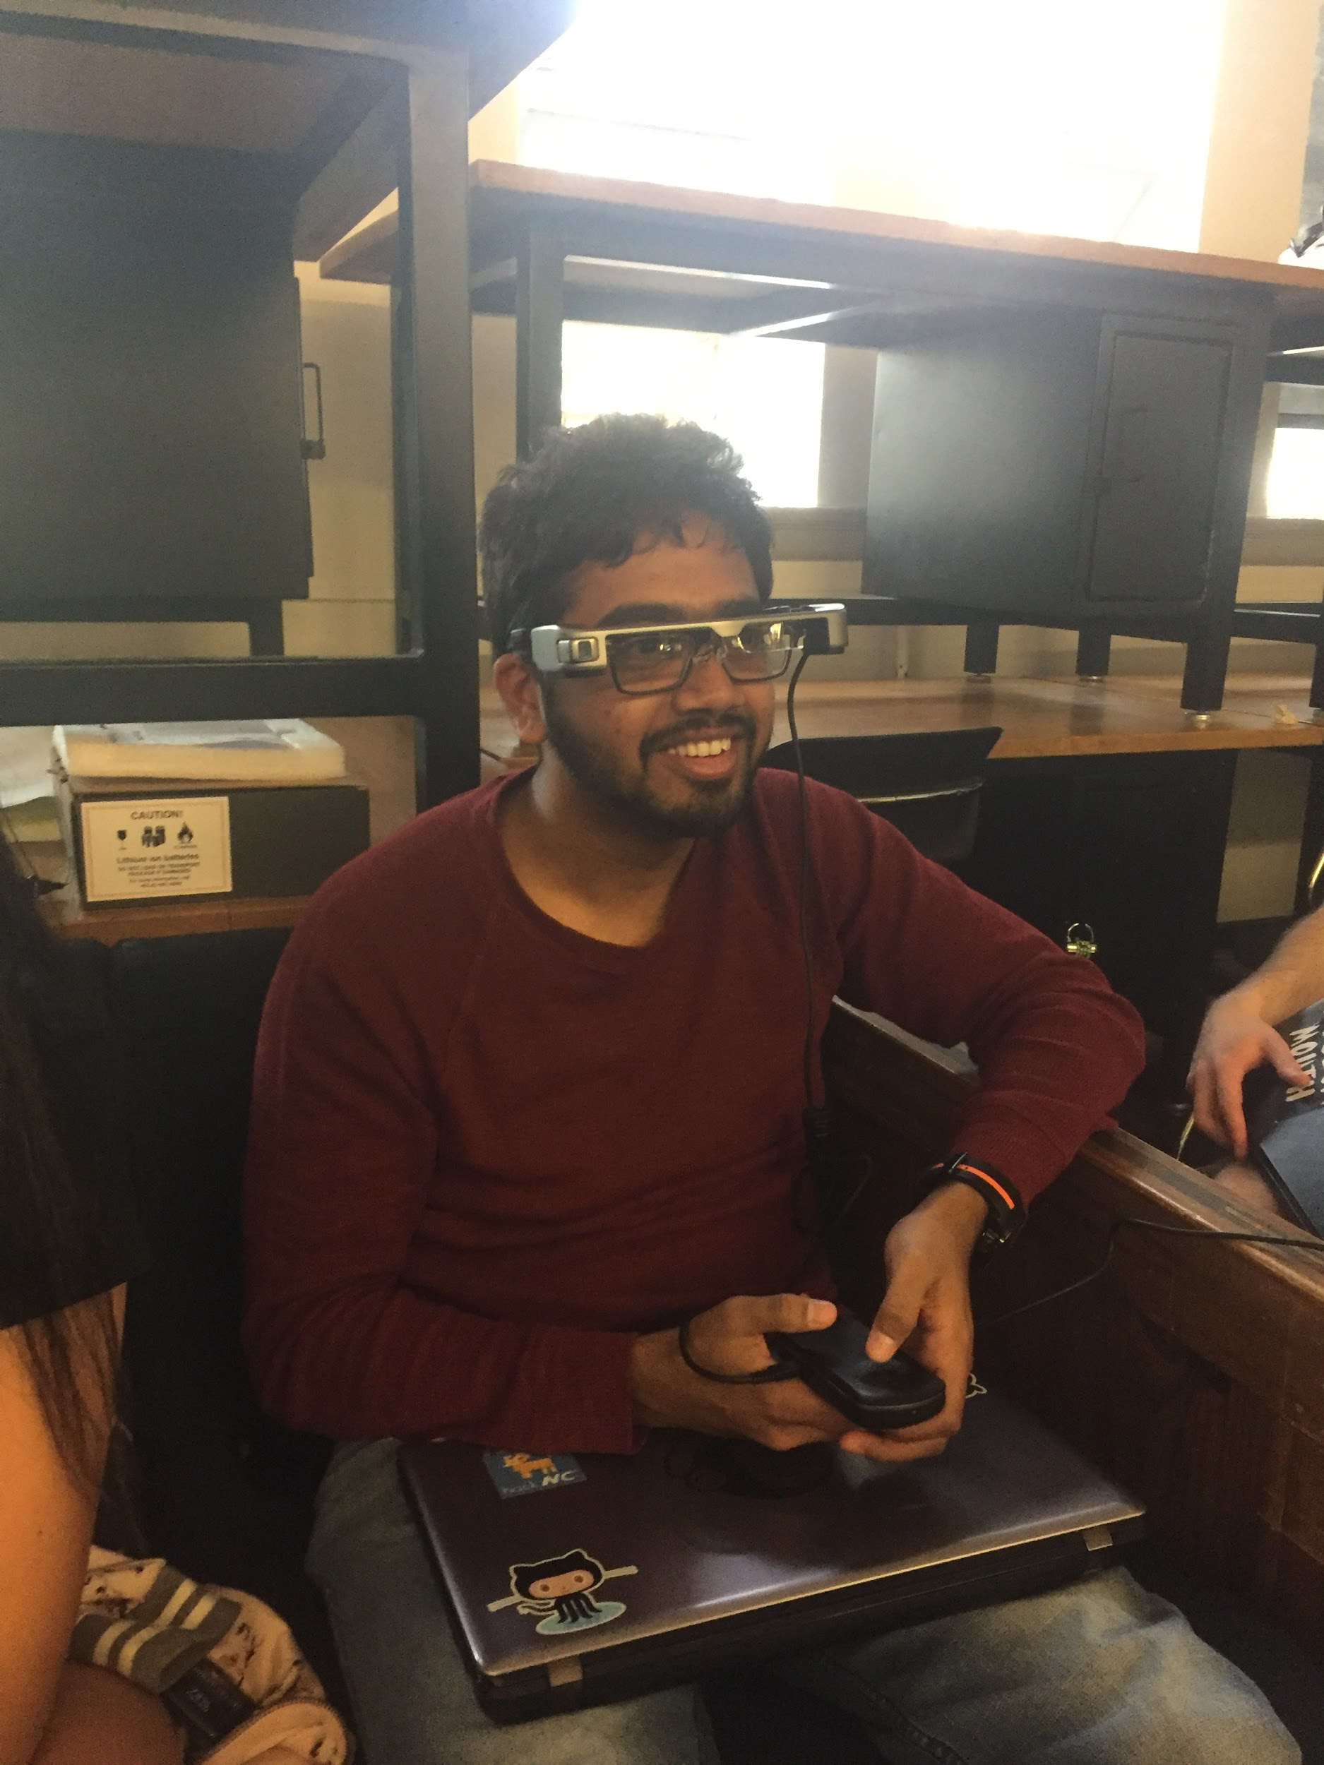
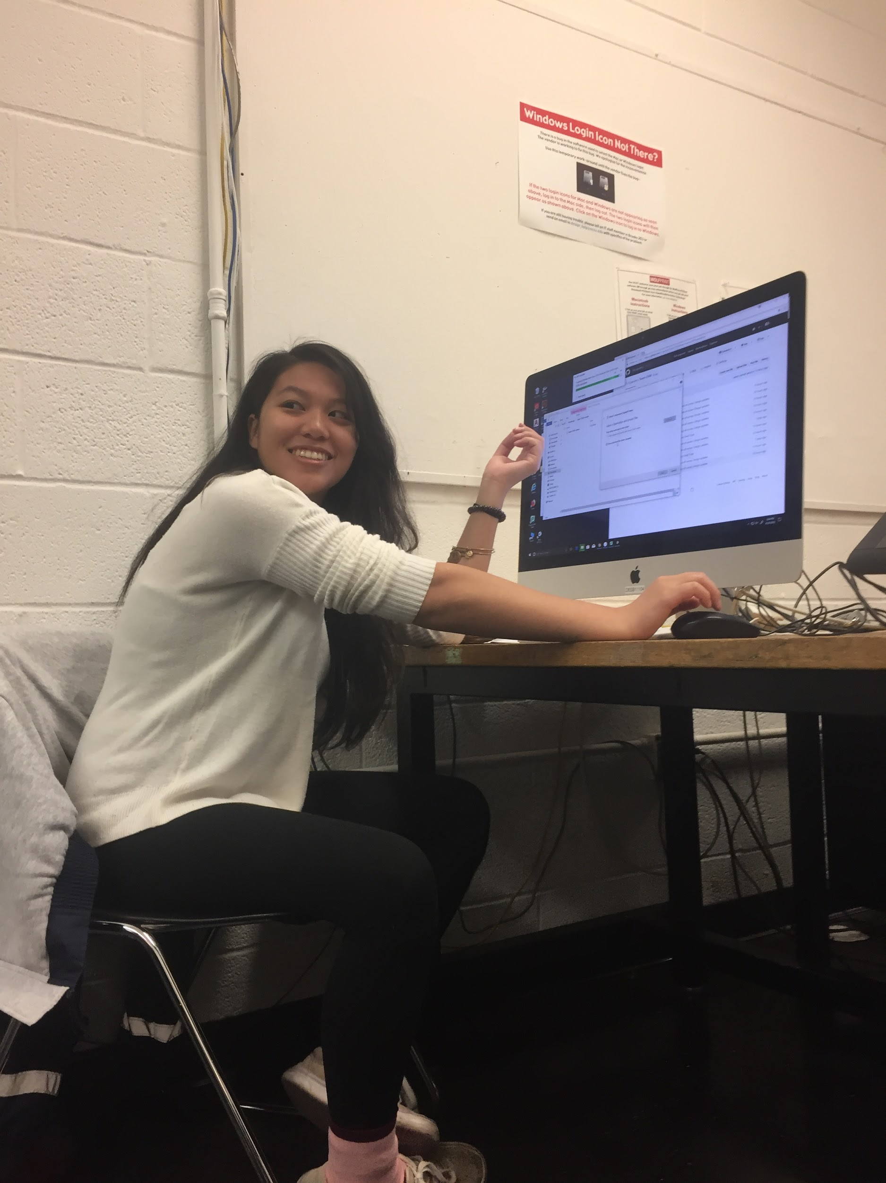
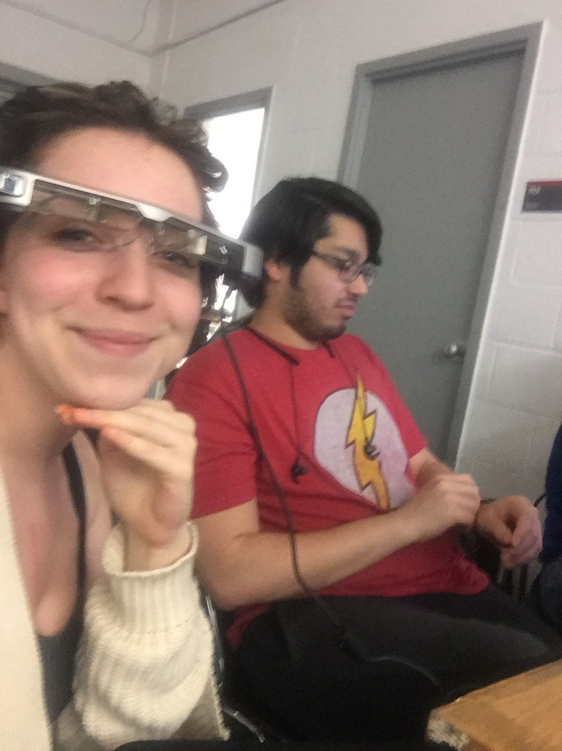
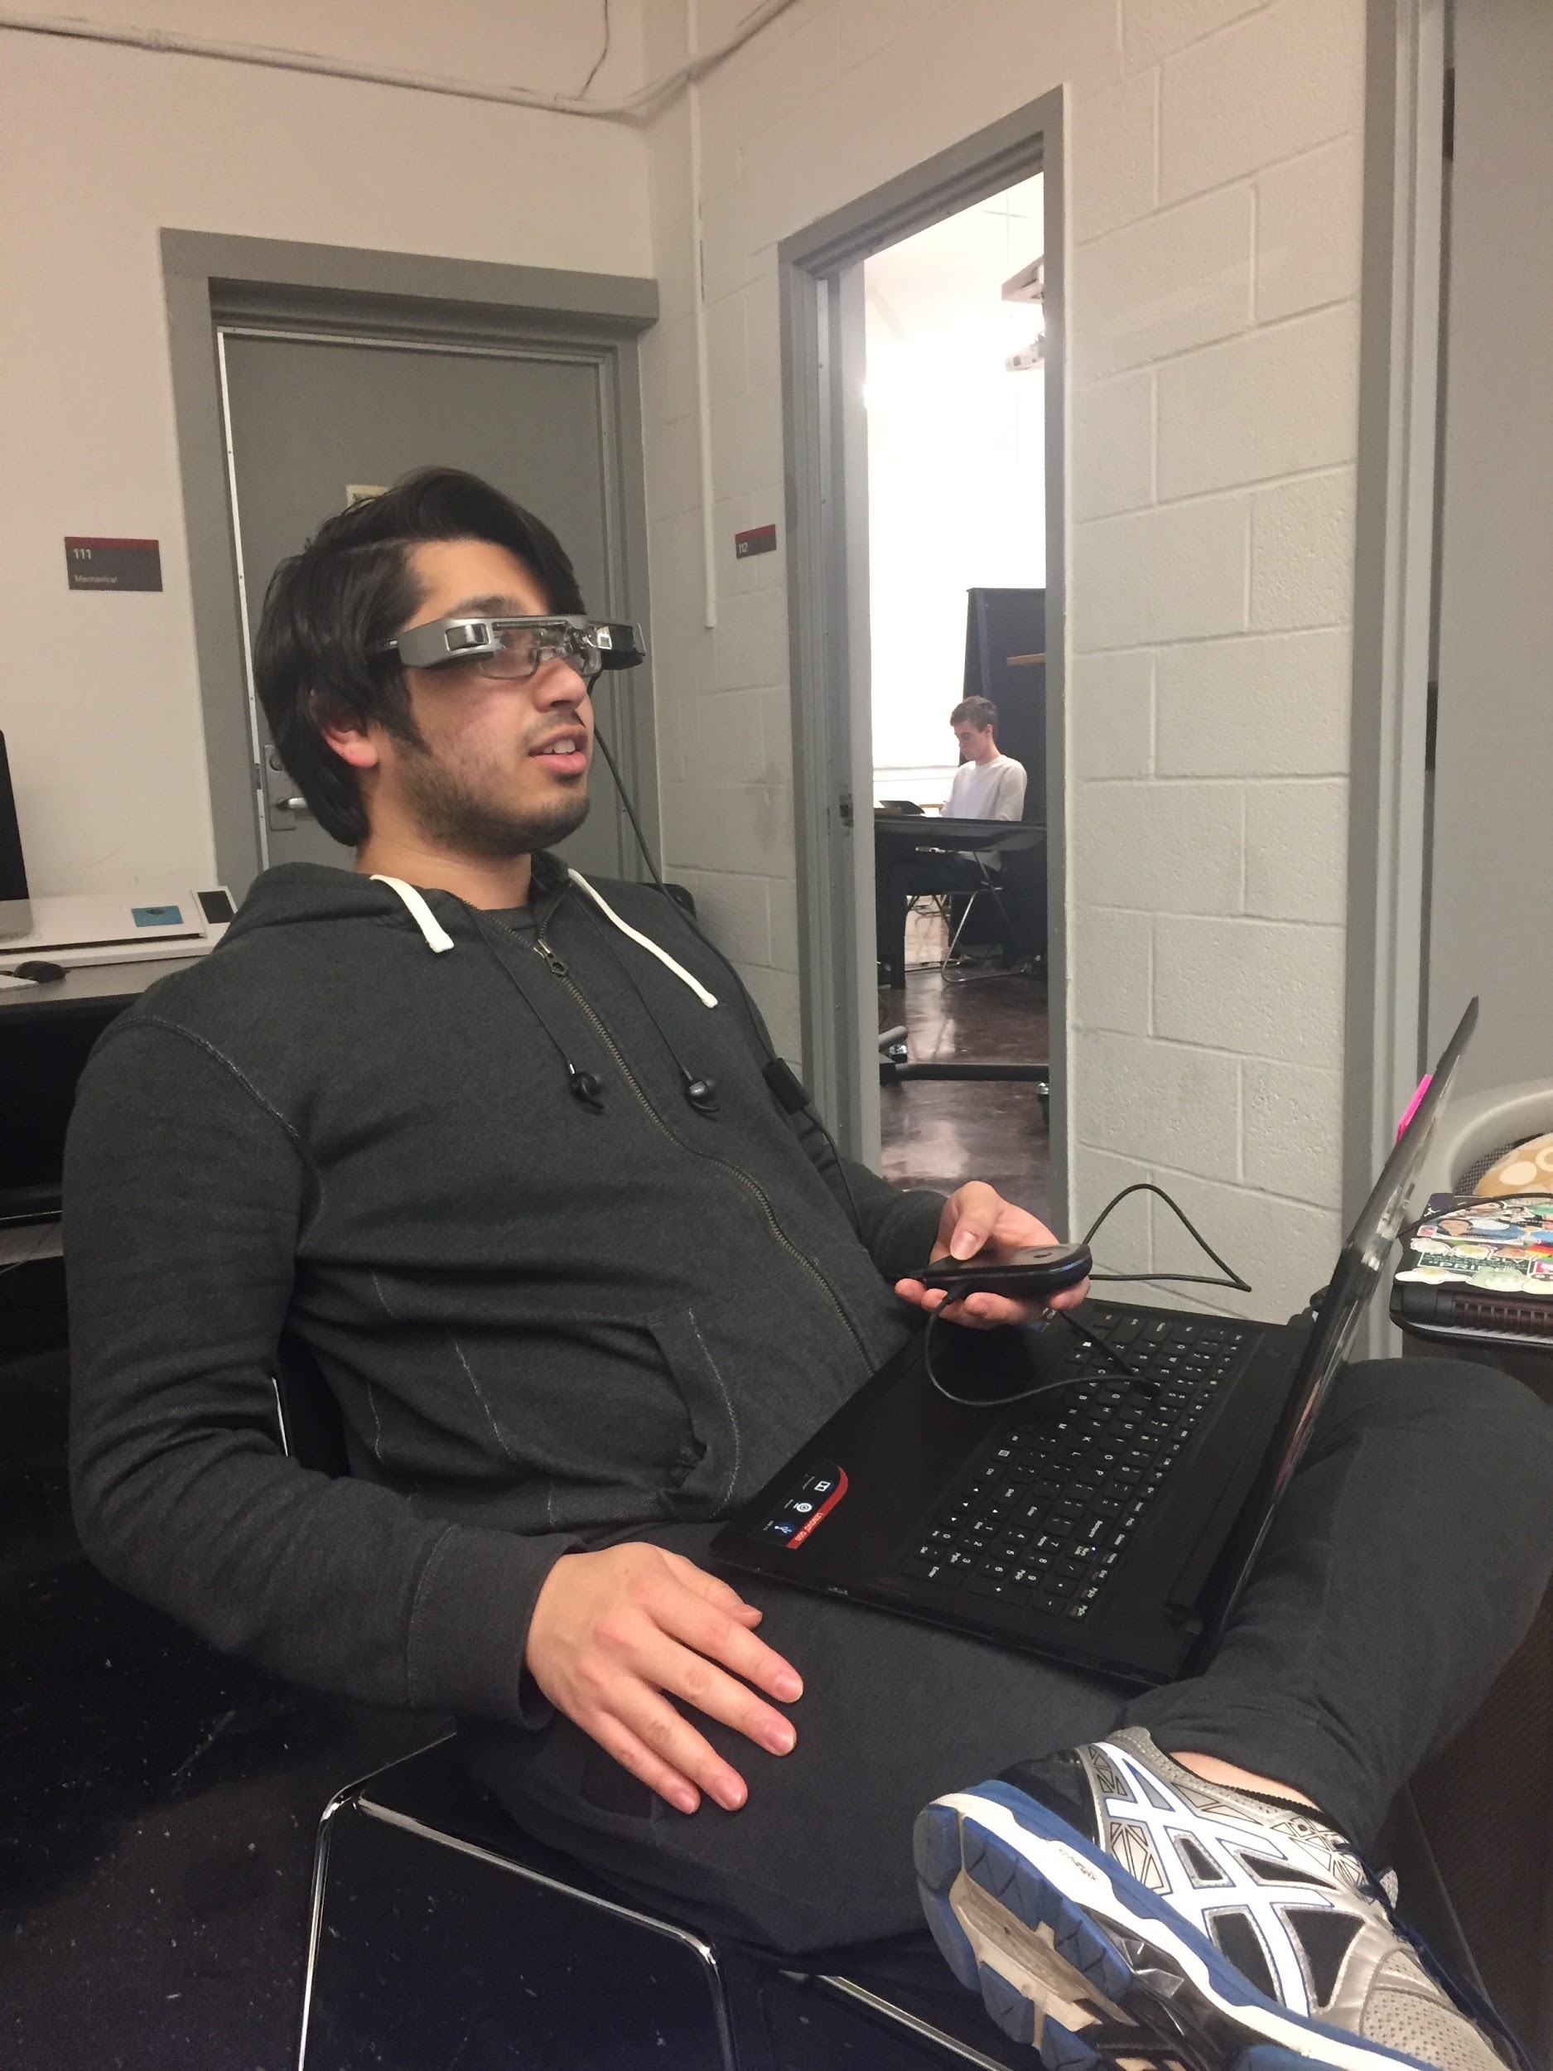
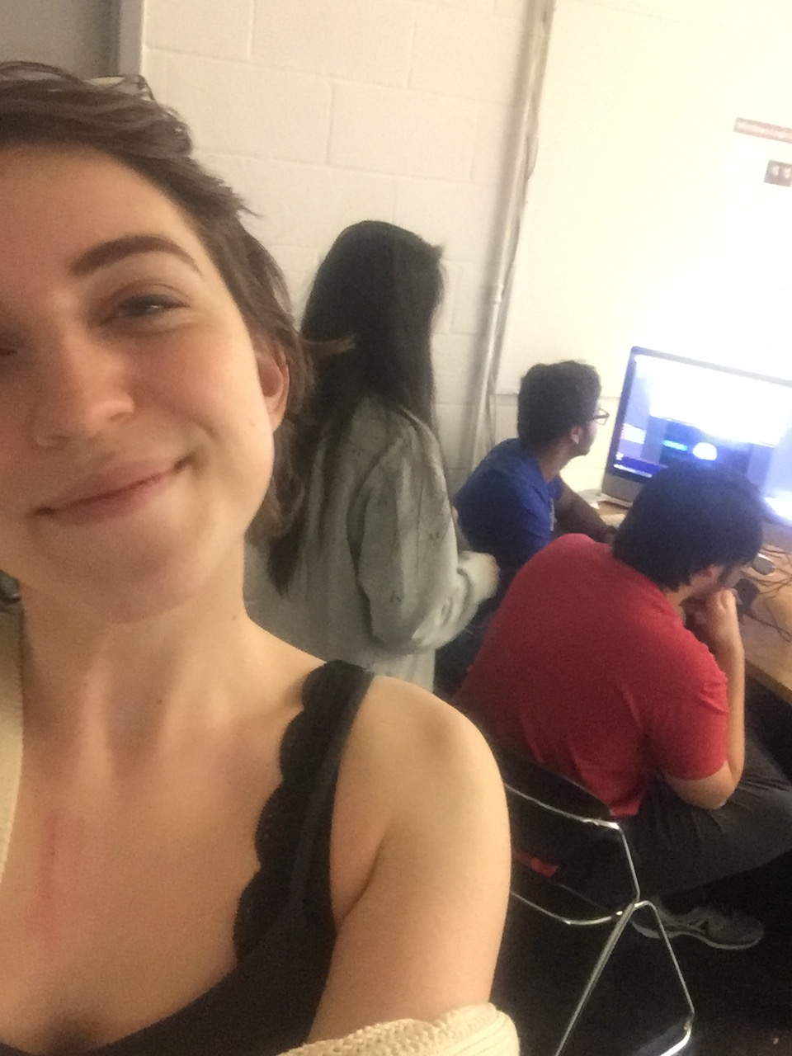
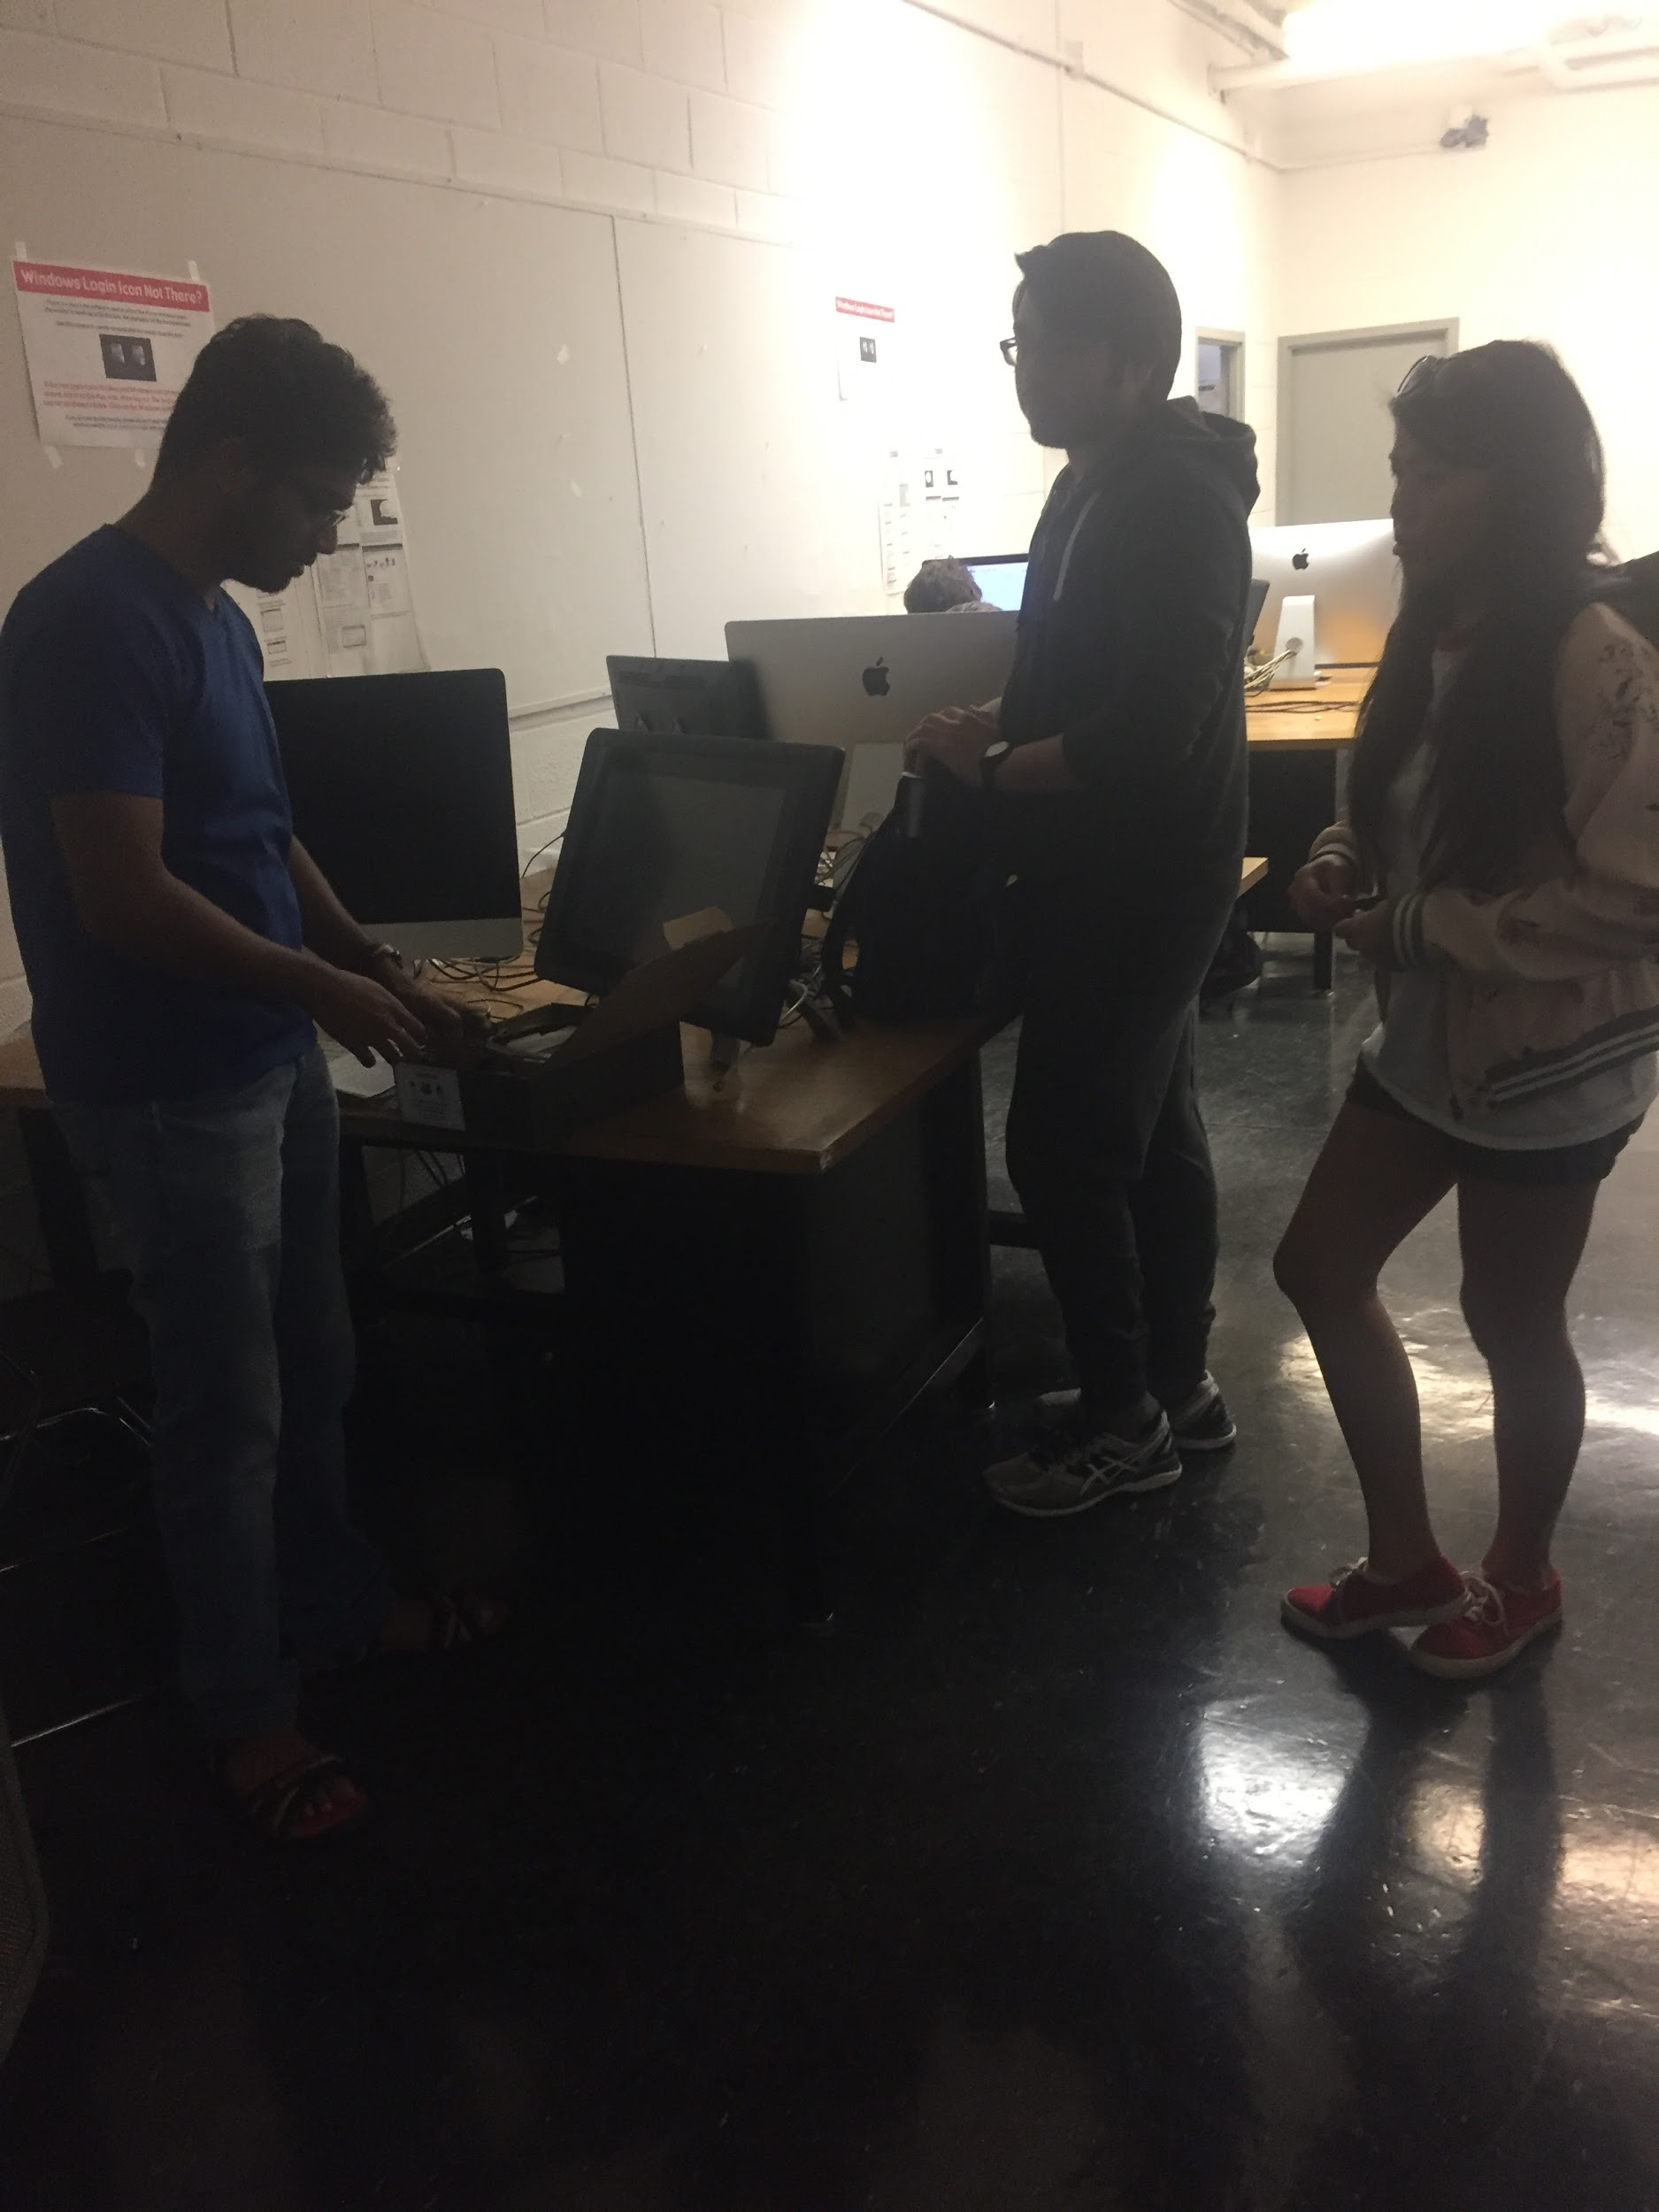
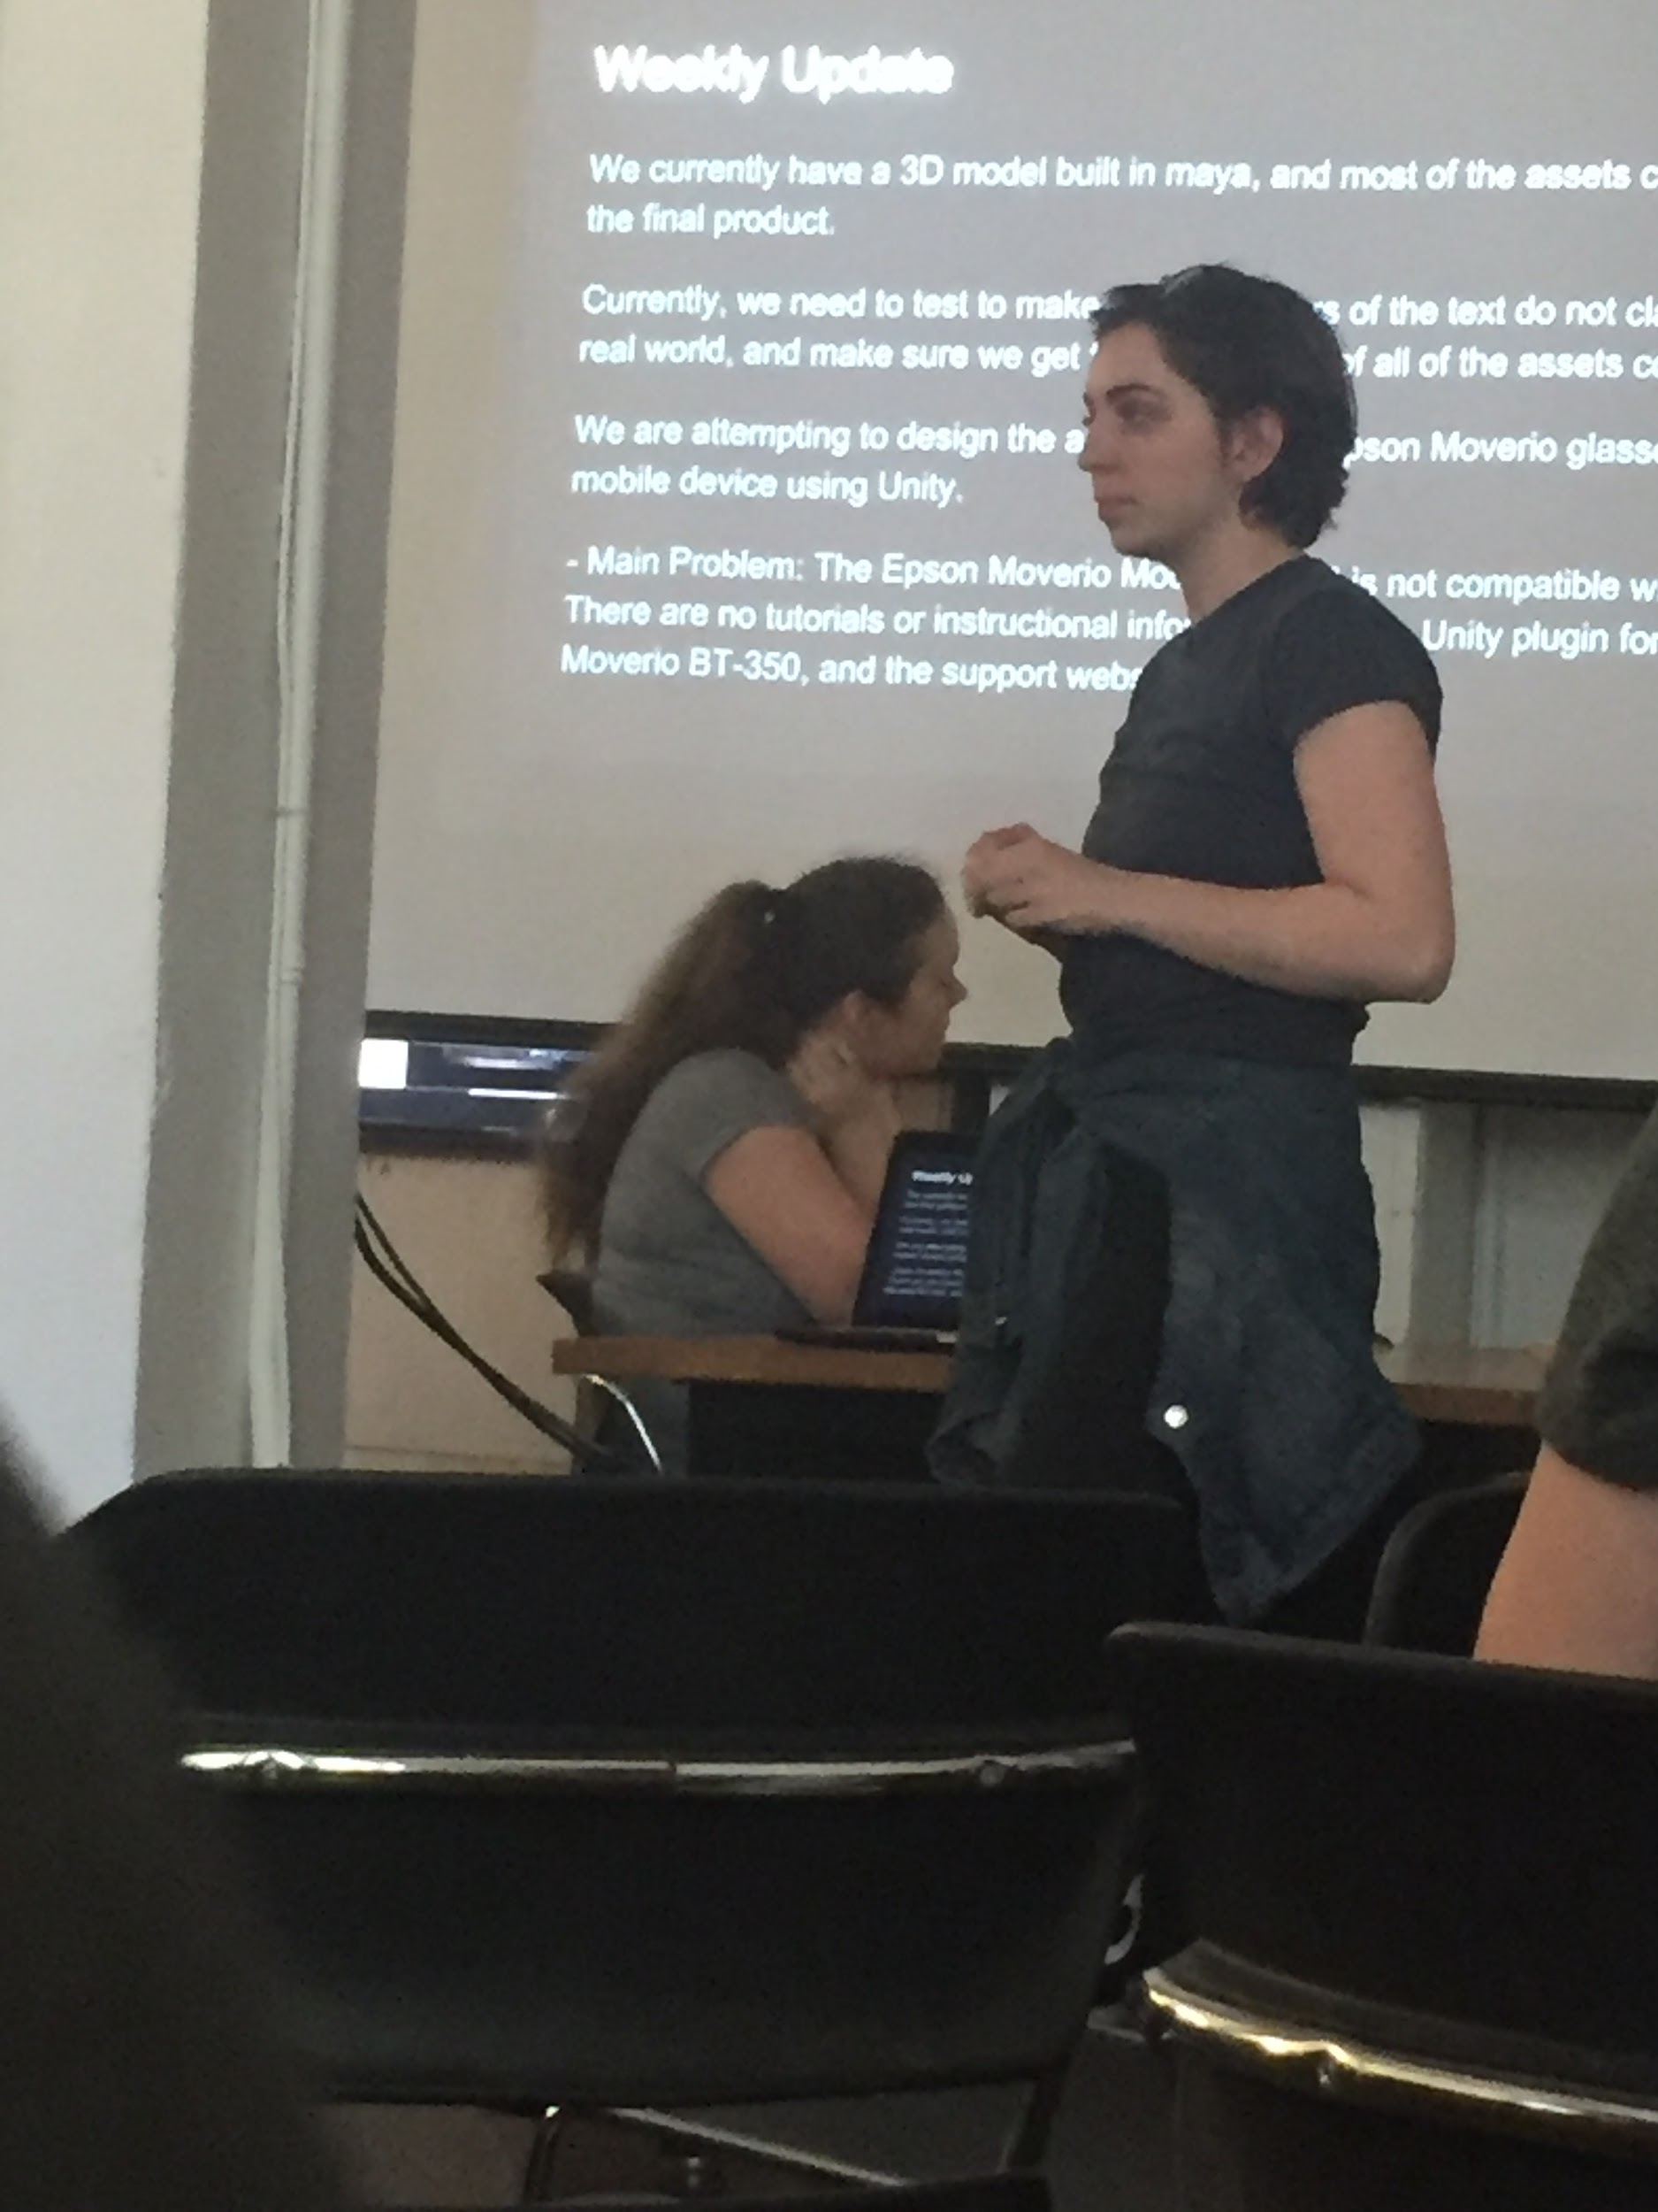
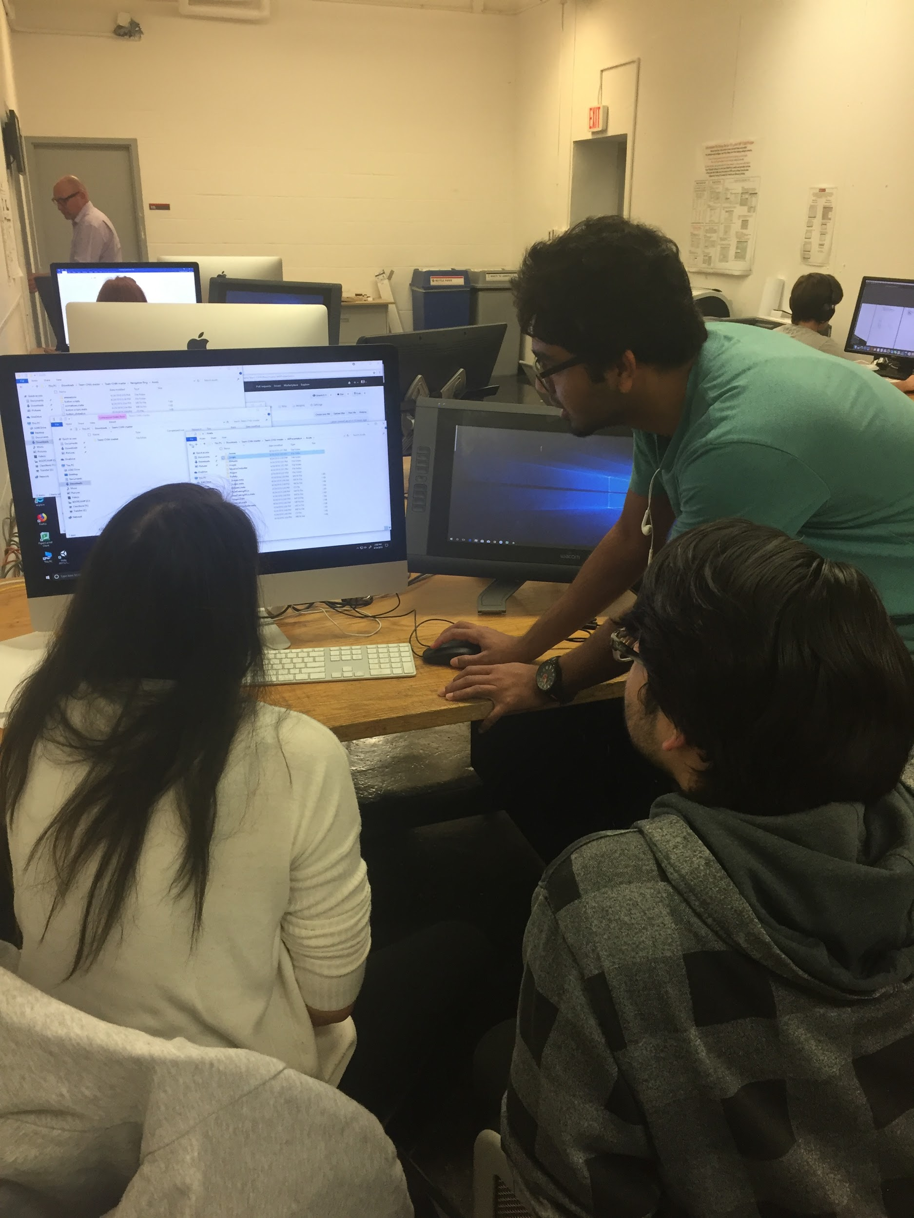

Slide 19
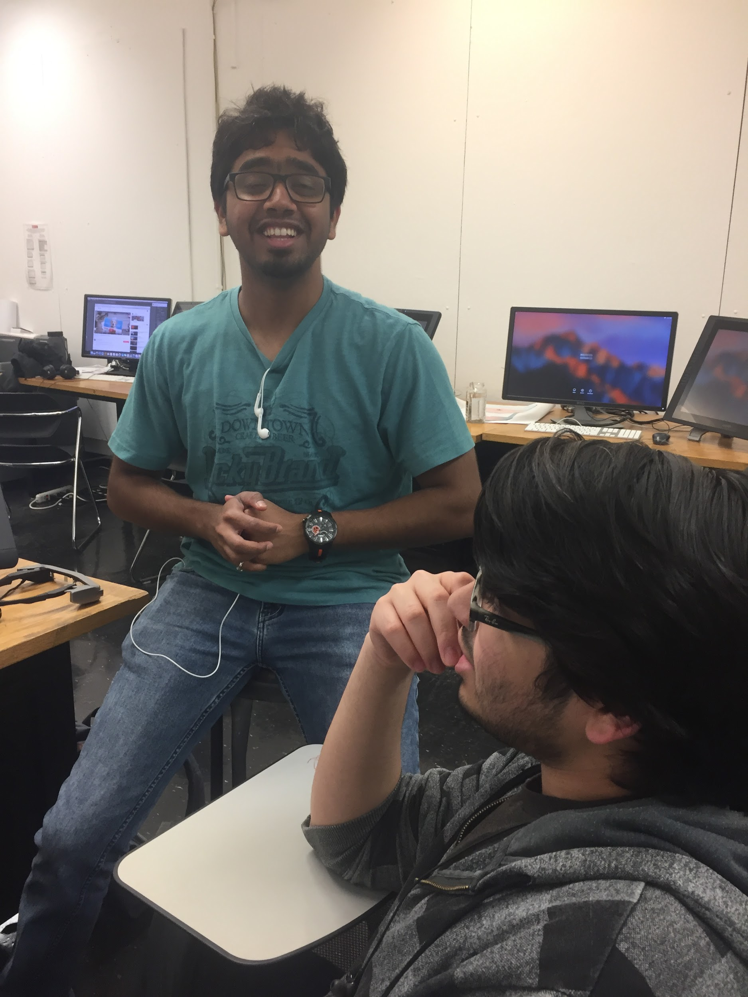
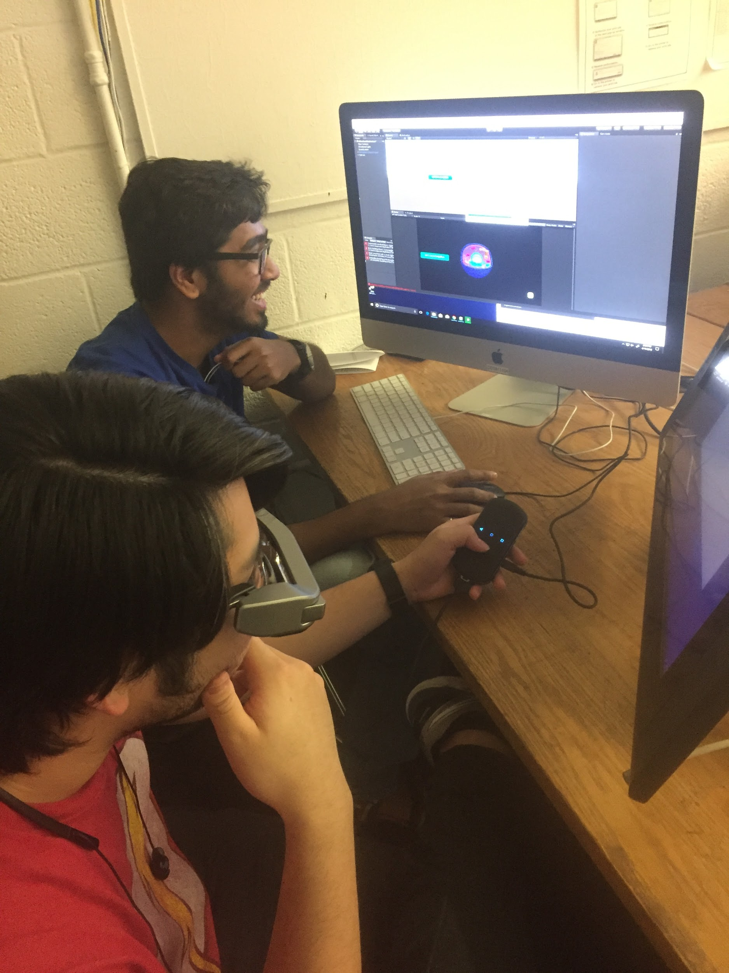
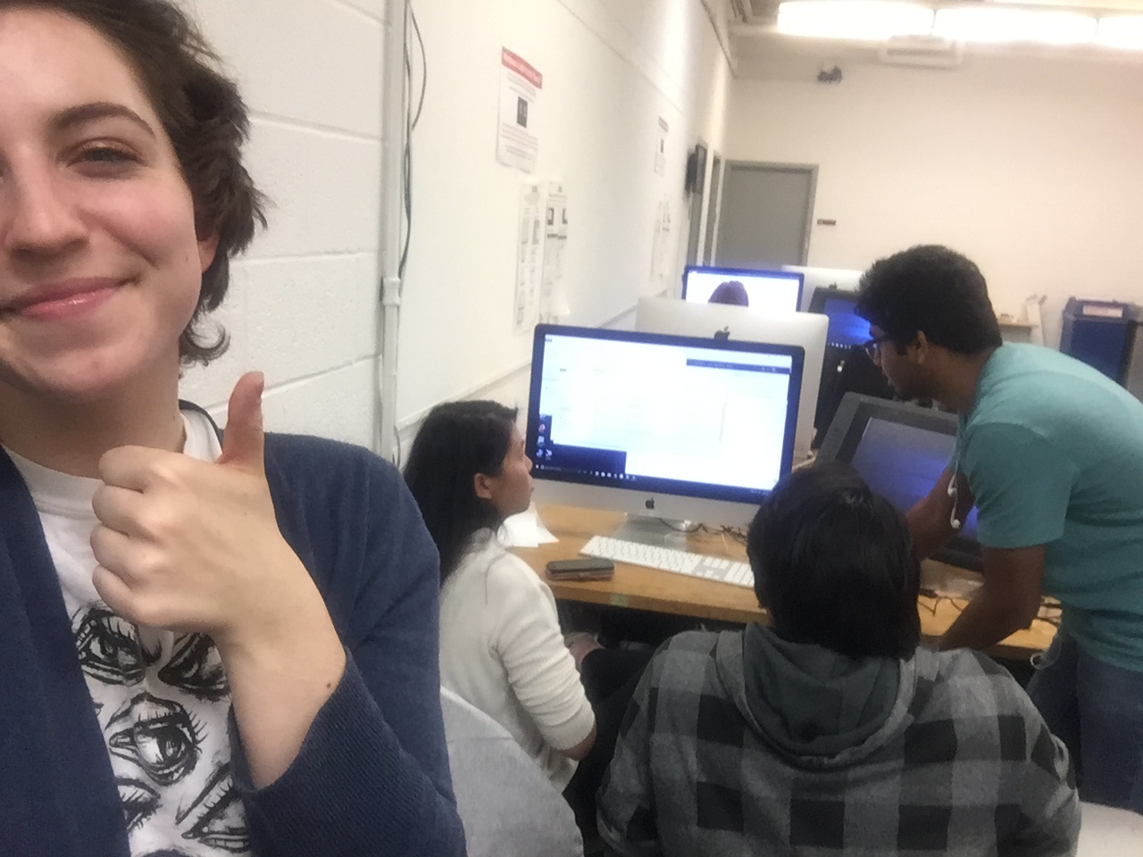
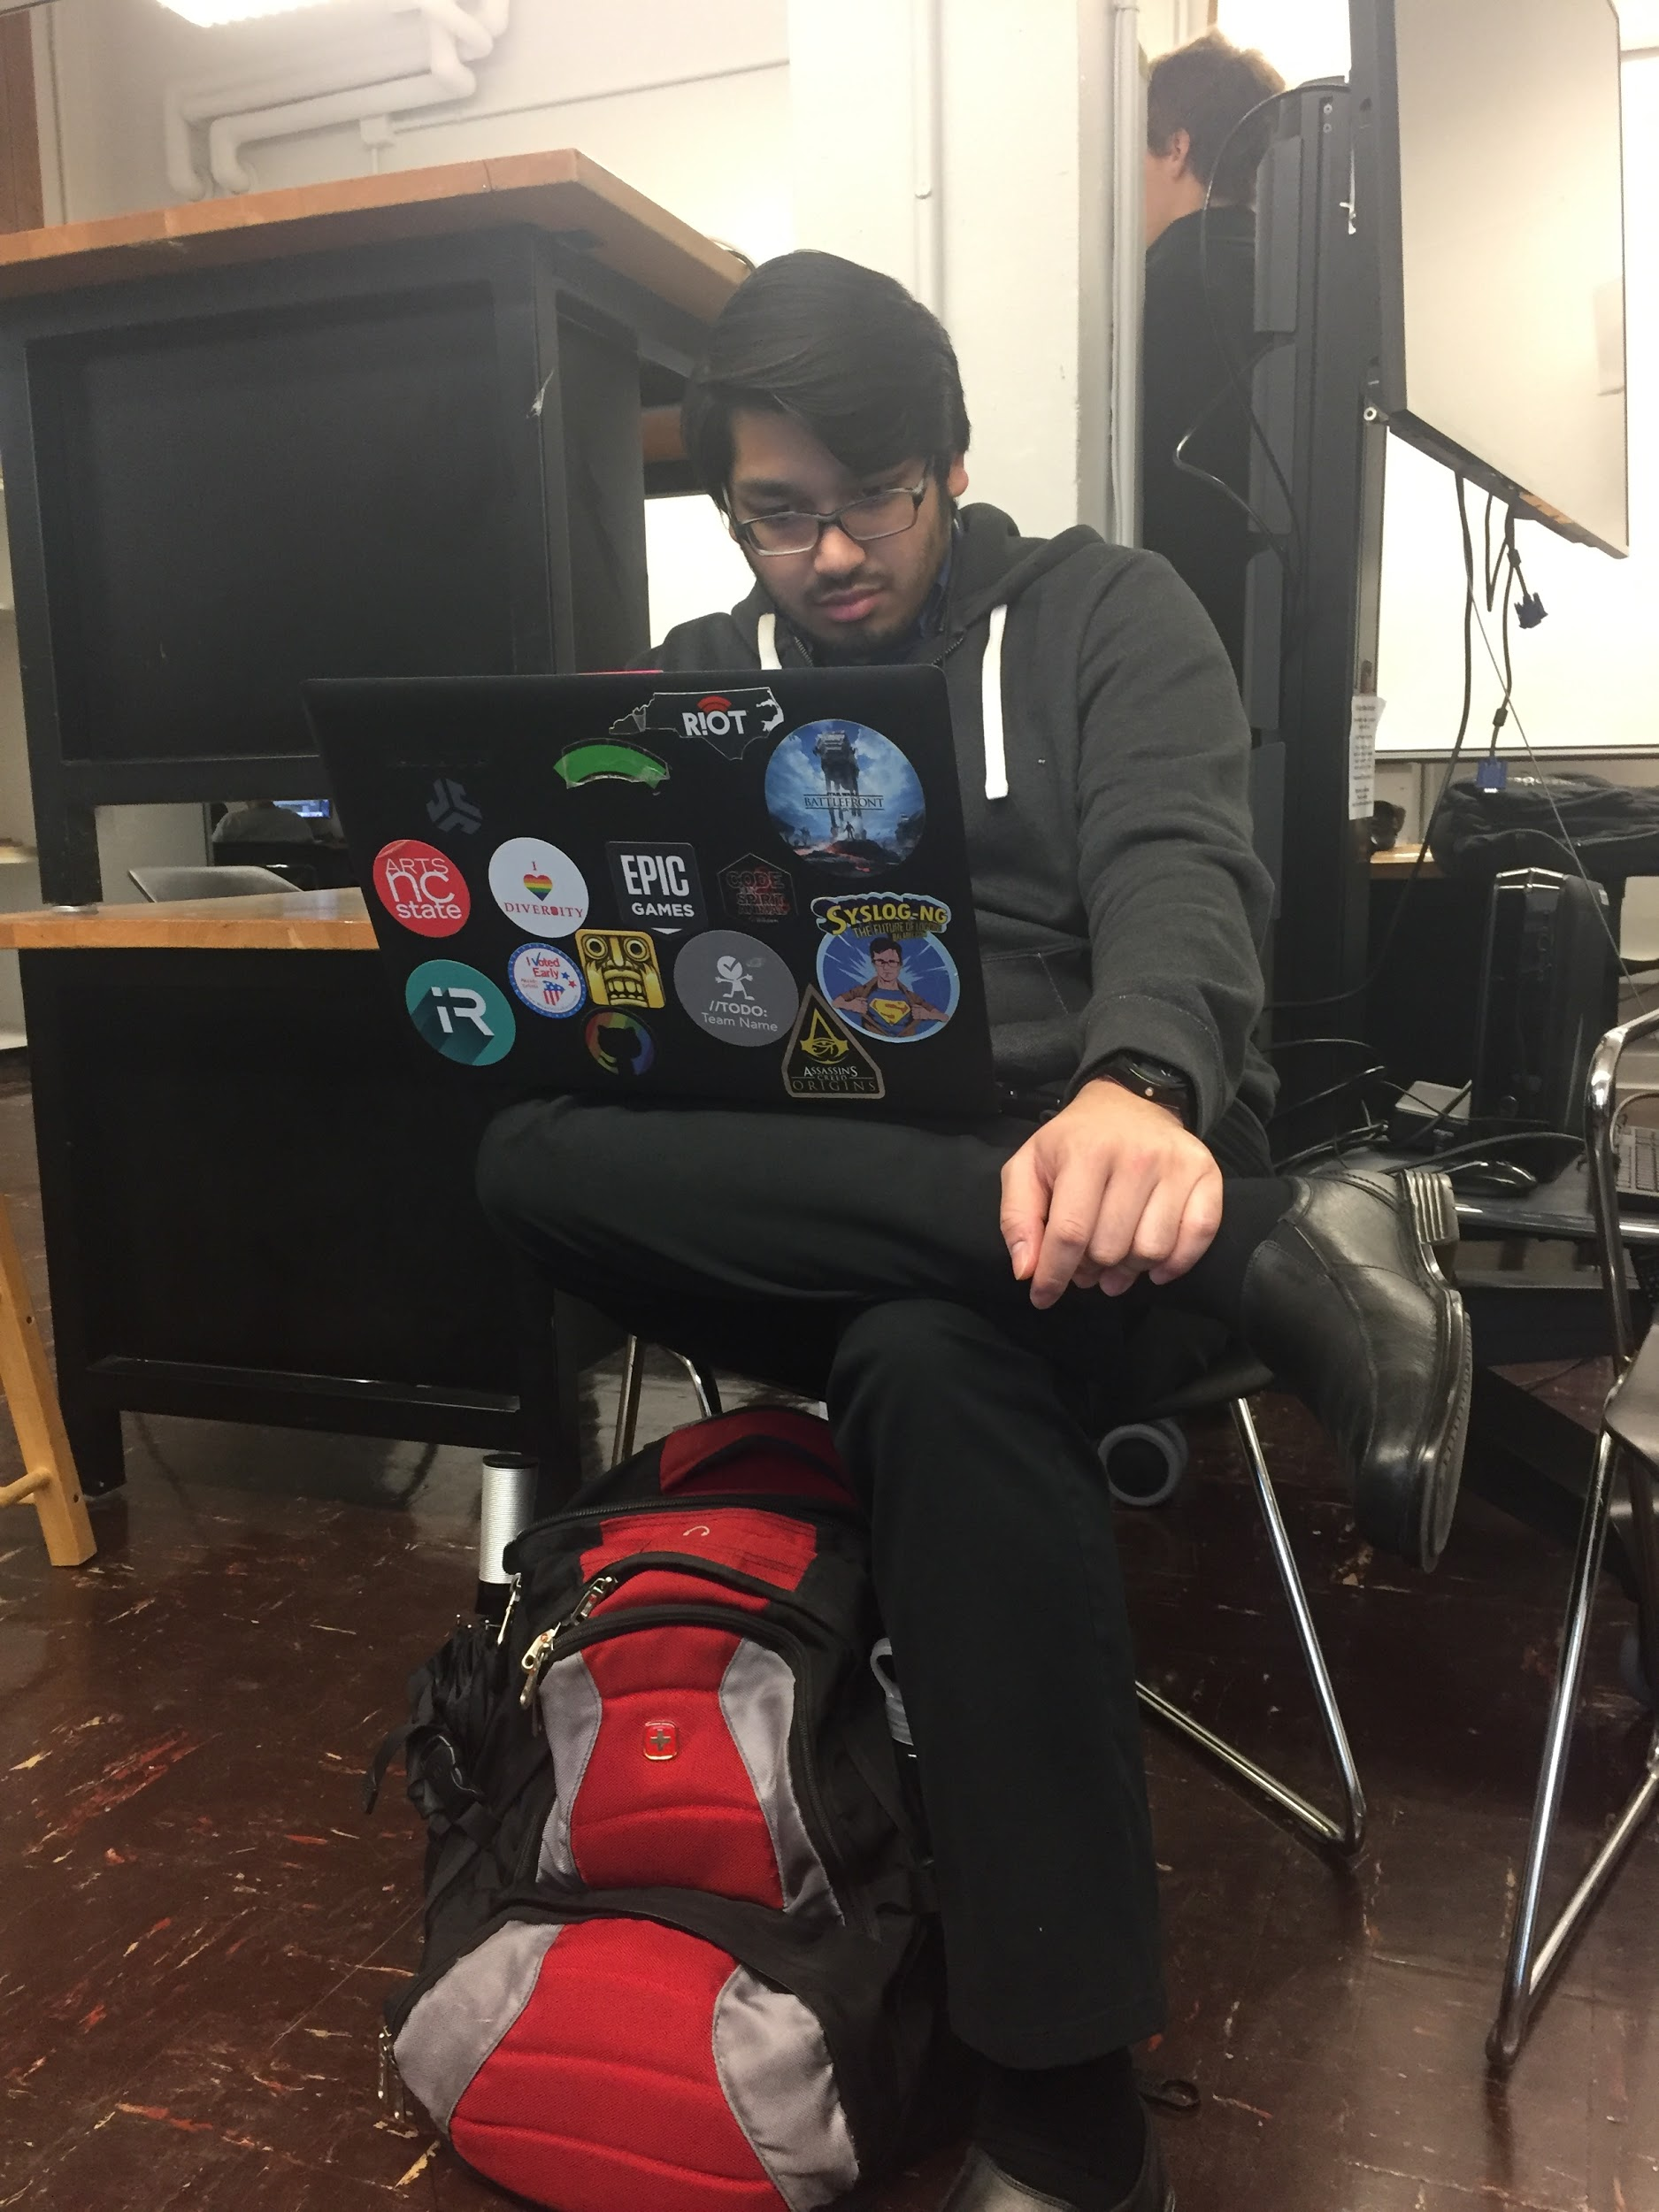
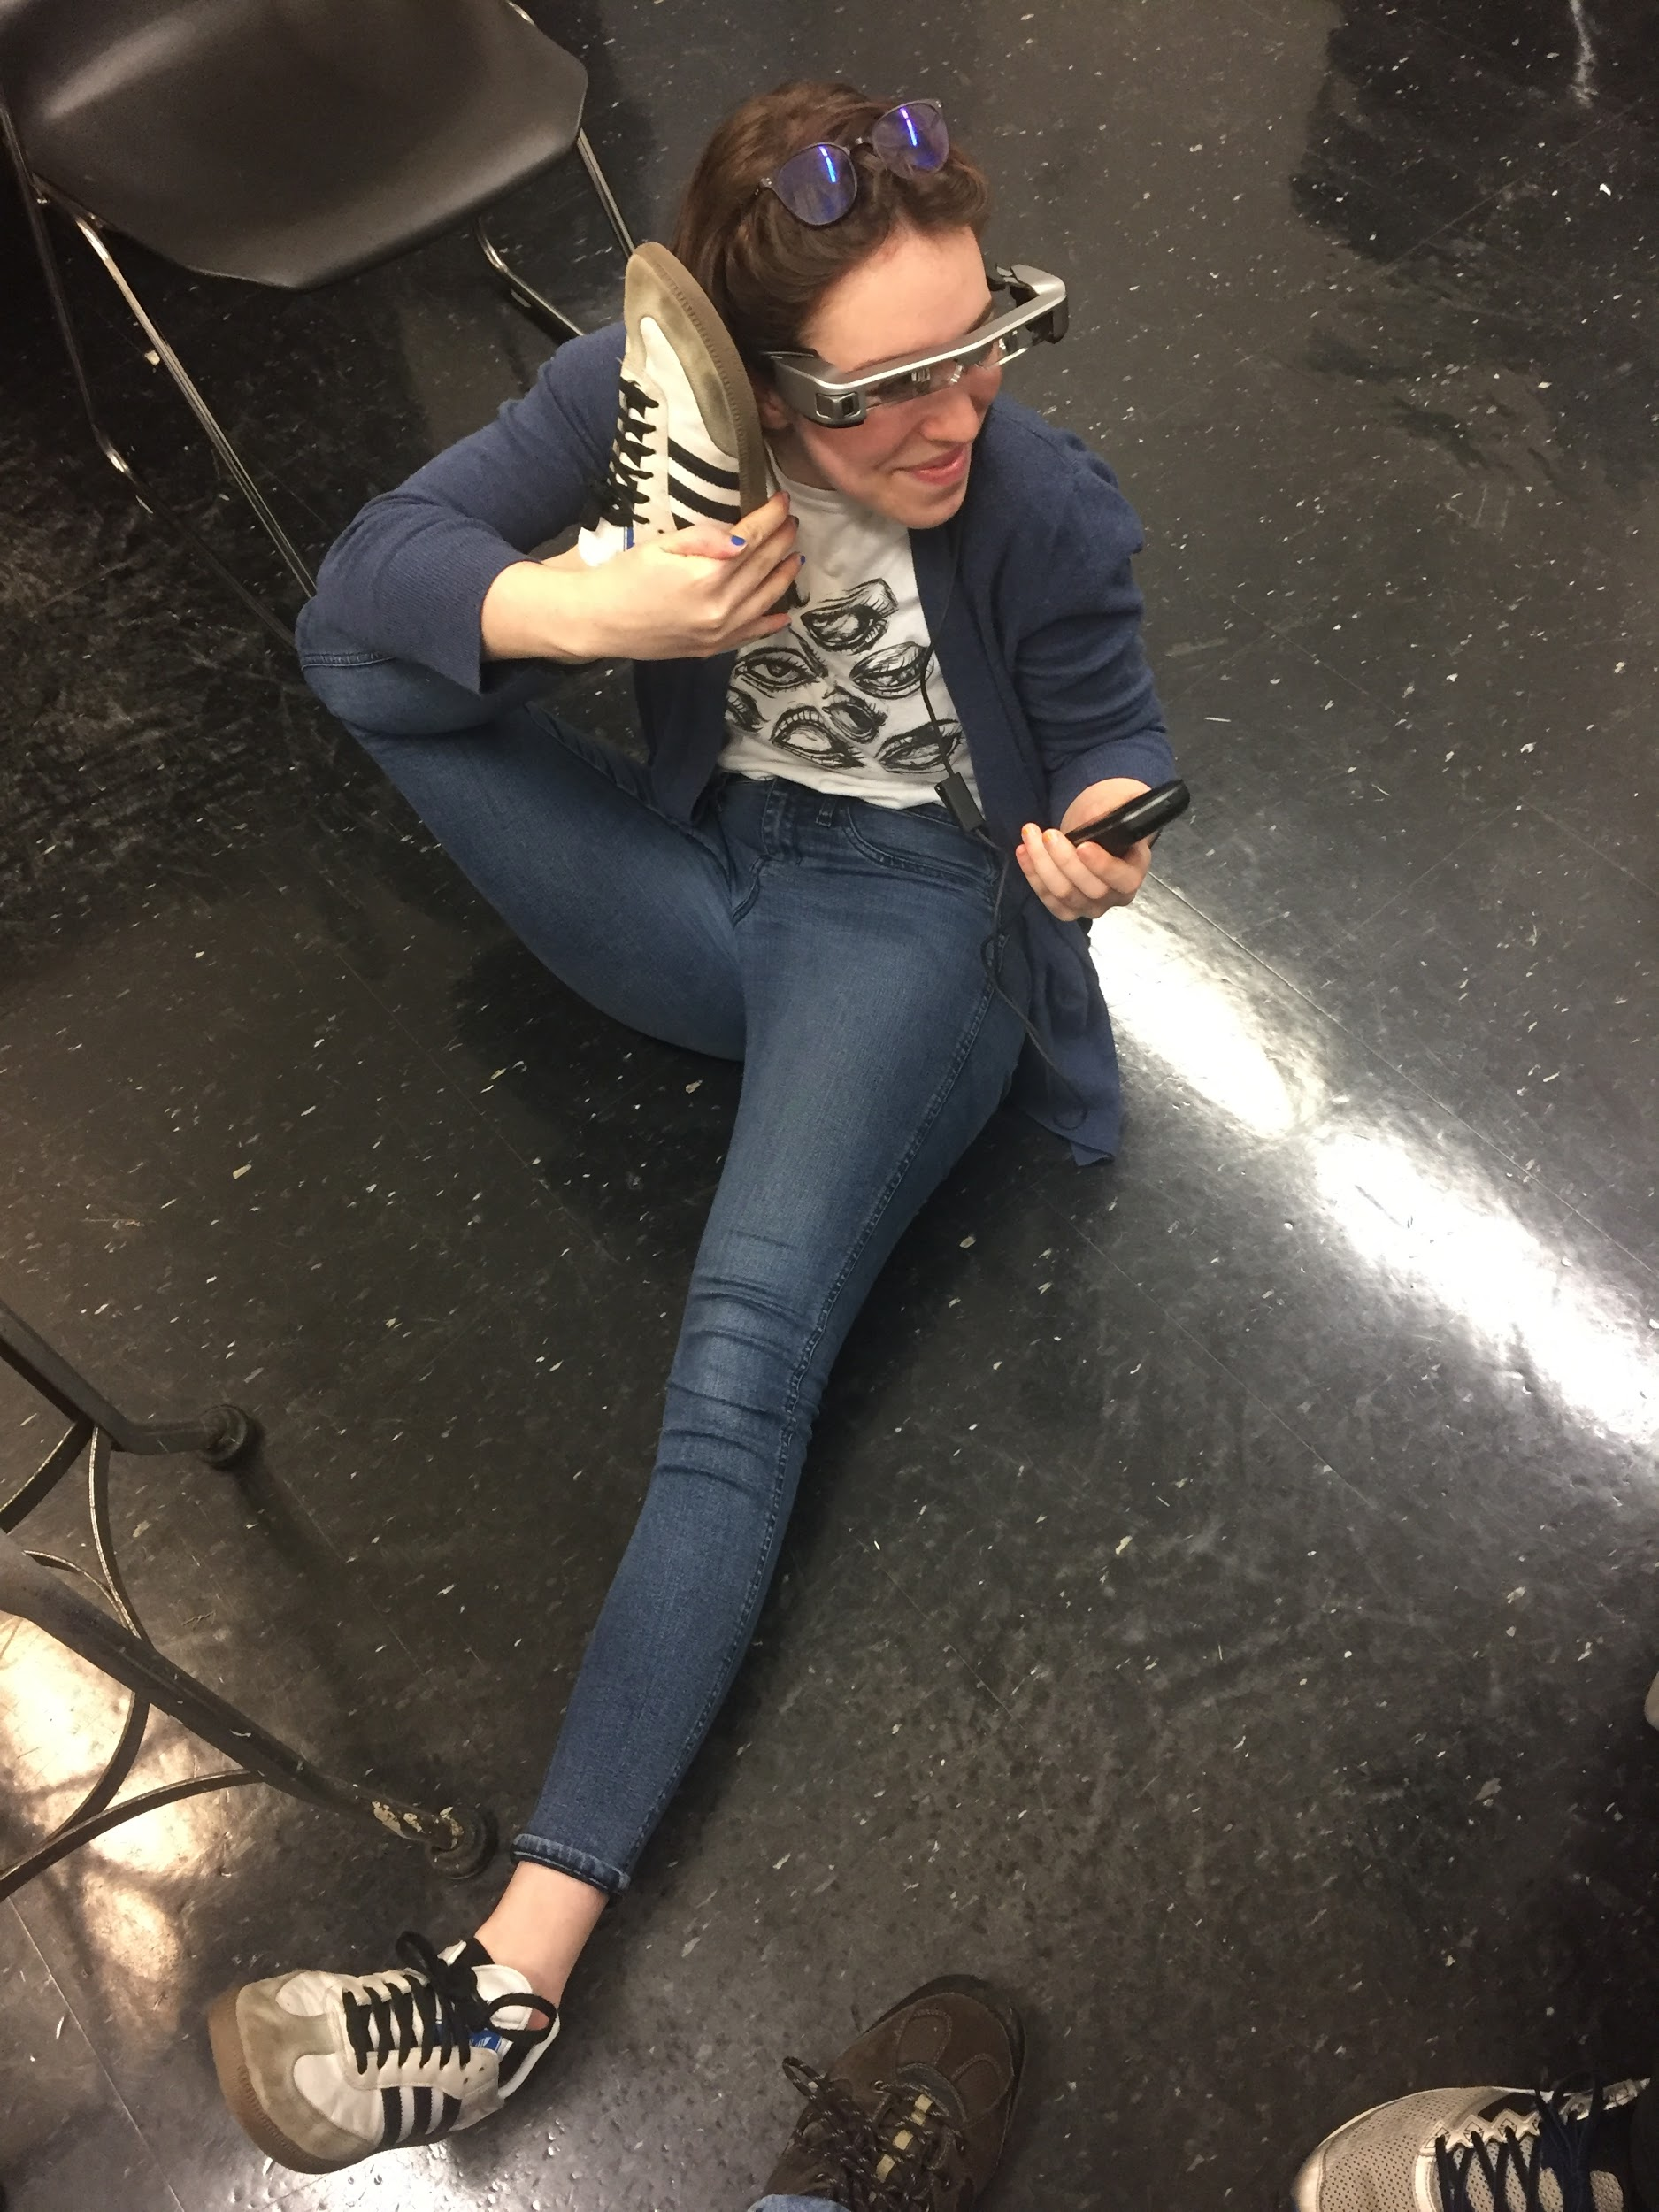
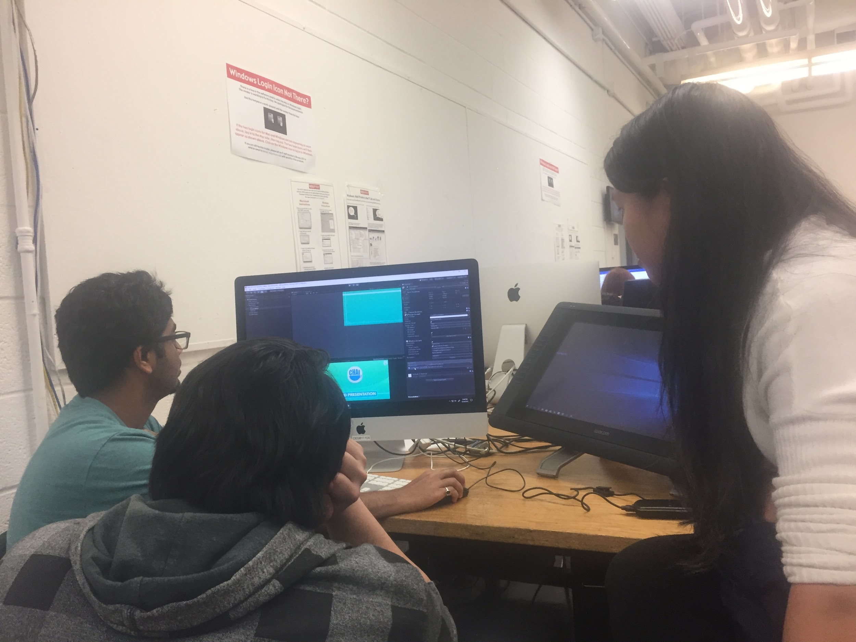

Slide 20
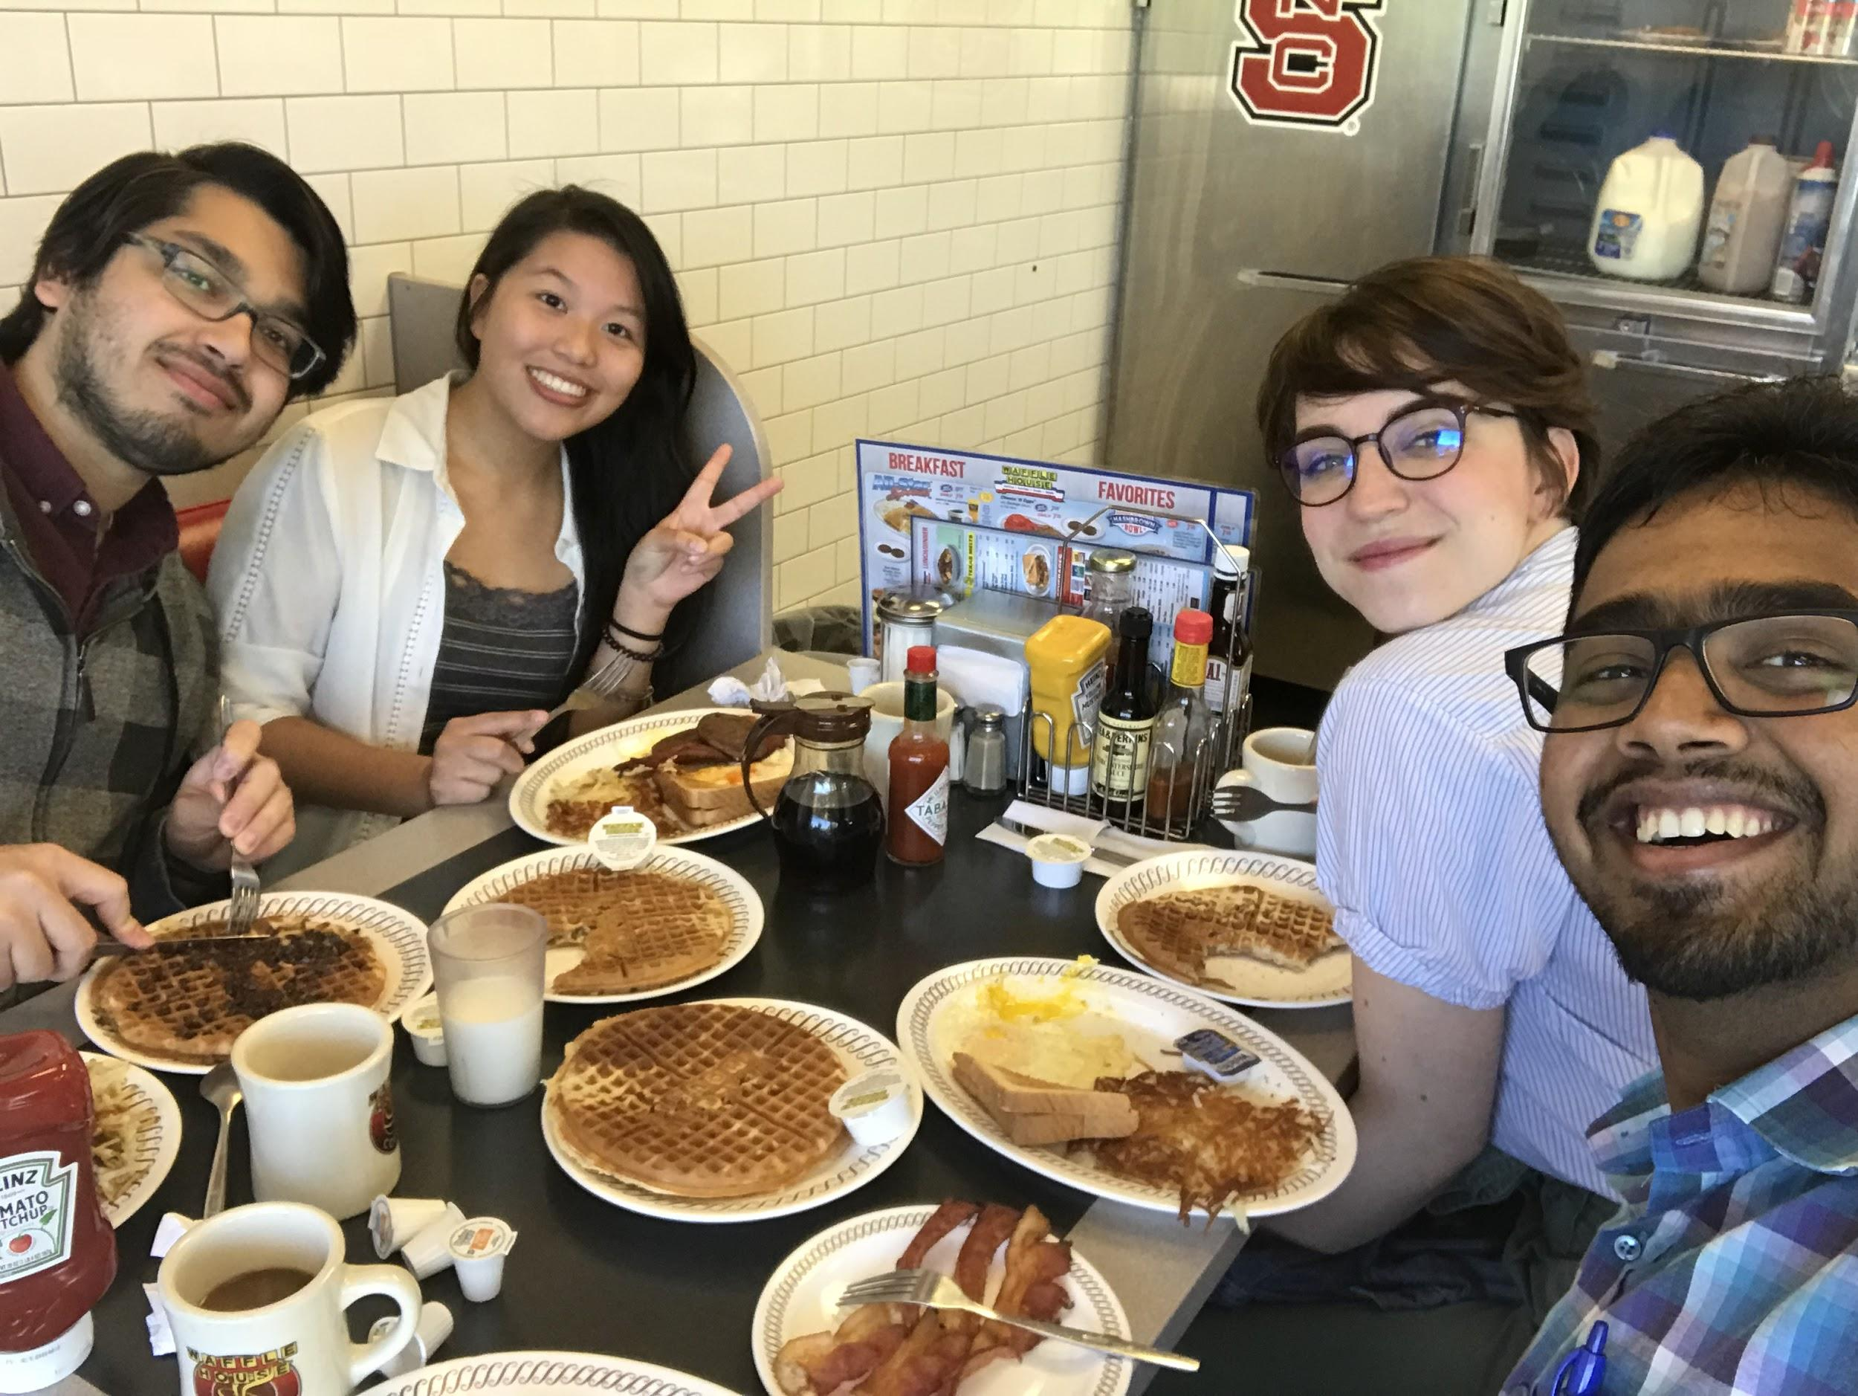
WE DID IT

Slide 21
SOURCES
http://www.softschools.com/science/biology/the_function_of_microfilaments/
http://www.enchantedlearning.com/subjects/animals/cell/
https://www.nature.com/scitable/definition/cytoplasm-280
http://bscb.org/learning-resources/softcell-e-learning/centriole/
https://biologydictionary.net/vacuole/
https://www.nature.com/scitable/definition/chromatin-182
https://www.nature.com/scitable/definition/nuclear-pore-279

